Slide 1
Fair
One of the WAVE values
WAVE value ‘Fair’ toolbox

Slide 2
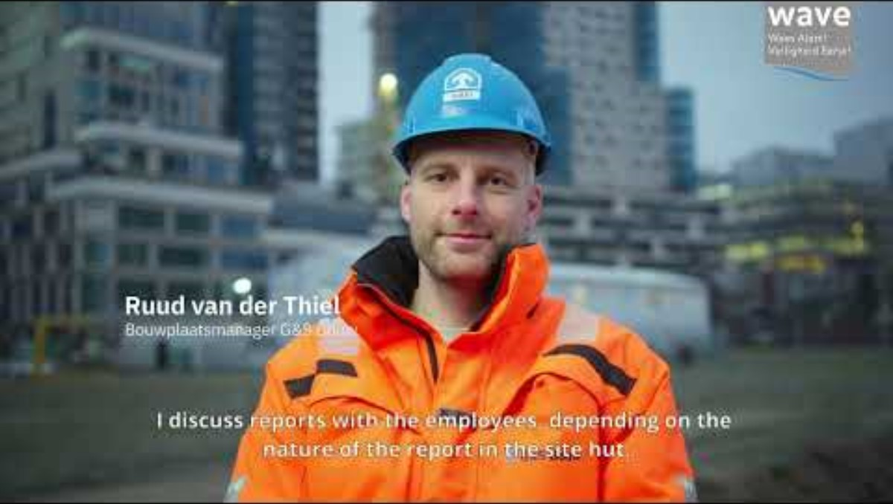
WAVE value Fair

Slide 3
Background
The WAVE values represent the safety behaviour desired by VolkerWessels. We are convinced that if we familiarise ourselves more with the WAVE values, we can prevent accidents together.
In this toolbox we consider the WAVE value ‘Fair’ – I report all accidents and near-accidents.
To go home safely every day, it is important that incidents are reported using the WAVE app. These reports allow us to learn from this and prevent similar situations in the future.
The toolbox includes tips on how you can implement the WAVE value ‘Fair.’

Slide 4
Subjects
The ‘Fair’ WAVE value animation
In dialogue

Slide 5
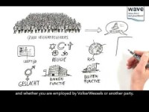
WAVE value Fair
Notes:
https://youtu.be/TDdISoyhCj4

Slide 6
In dialogue
Have you ever experienced a situation that, in retrospect, you wish you had reported?
Which situations are not worth reporting in your opinion?

Slide 7
Thank you for your attention!
veiligheid@volkerwessels.com

Slide 8
Additional questions for dialogue
Additional questions for the toolbox at office and/or operational work locations. The questions can be used at your discretion.
How do you arrive at a collaboration in which reporting situations is considered normal? What have you already done and/or what do you still have to do about this?
Who has ever received praise via the WAVE app? If so, why did the colleague deserve praise?
Who has ever reported a situation?
Statement: reporting situations only applies to construction site employees. Explain your opinion.
Are there any situations in which you consider whether or not to report something so as not to harm yourself or others?
Who has the WAVE app on their phone? What was the last thing you reported?

