Slide 1
Working safely with electrical equipment
Toolbox

Slide 2

Background
Safety and Sustainability are core values at VolkerWessels.
To achieve emission-free construction by 2030, the use of electric equipment will increase in the coming years. Working with and around electrical equipment involves a number of specific safety hazards, so it is good for all of us to be aware of them.
In this toolbox we consider the specific risks involved in working with electrical equipment. Tips are given on how you can work safely with electrical equipment.

Slide 3
Subjects
"Working safely with electrical equipment" animation
In dialogue

Slide 4
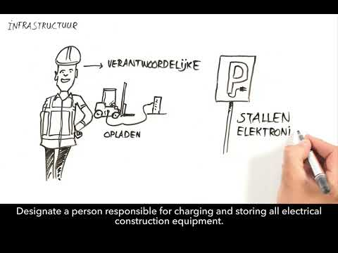
Working safely with electrical equipment
Notes:
https://youtu.be/WK7bpMFExao

Slide 5
In dialogue
Do you already have experience working with electrical equipment?
Have you ever faced the risks associated with electrical equipment?

Slide 6
Thank you for your attention!
veiligheid@volkerwessels.com
Sustainability Knowledge Centre

