Slide 1
Respect
One of the WAVE values
WAVE value ‘respect’ toolbox

Slide 2
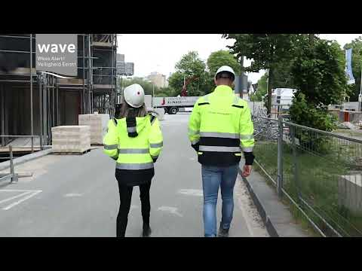

Slide 3
Background
In the coming years, we will be highlighting the WAVE values. The WAVE values represent the safety behaviour desired by VolkerWessels. We are convinced that if we familiarise ourselves more with the WAVE values, we can prevent accidents together.
In this toolbox we discuss the WAVE value ‘Respect’ - I accept being held accountable for safety.
To return home safely every day, our safety leaders must ensure a socially safe and respectful working environment, so holding each other accountable and being held accountable is accepted.
The toolbox includes tips on how you can implement the WAVE value ‘Respect’

Slide 4
Subjects
The ‘respect’ WAVE value animation
In dialogue

Slide 5
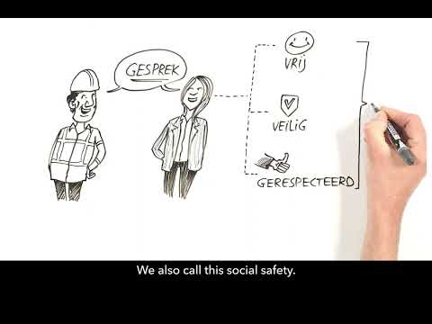
WAVE value respect
Notes:
https://youtu.be/WK7bpMFExao

Slide 6
In dialogue
What does respect mean to you?
Have you ever been treated disrespectfully at work?

Slide 7
Thank you for your attention!
veiligheid@volkerwessels.com

