Slide 1
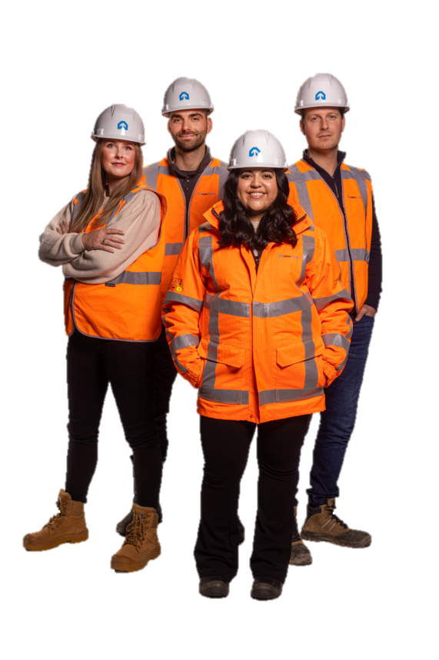
Consistent
One of the WAVE values
Toolbox WAVE value ‘Consistent’

Slide 2
Background
In the coming years, we will be focusing even more strongly on the WAVE values. The WAVE values represent the safety behaviour that VolkerWessels wants to see. Because we are convinced that if we internalise the WAVE values even more fully, we will prevent accidents together.
In this toolbox, we look at the WAVE value ‘Consistent’ – Safety is part of everything we do.
In order to return home safely every day, as a safety leader it is important to be consciously thinking about safe working in every phase of our work activities.
The toolbox gives tips about how you can put the WAVE value ‘Consistent’ into practice

Slide 3
Subjects
The 'WAVE value Consistent' animation
Talking to each other

Slide 4
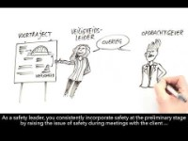
WAVE value ‘Consistent’
Notes:
https://youtu.be/WK7bpMFExao

Slide 5
Talking to each other
What does being consistent mean to you?
How do you consistently incorporate safety during your work activities?

Slide 6
Thank you for your attention!
veiligheid@volkerwessels.com

