Slide 1
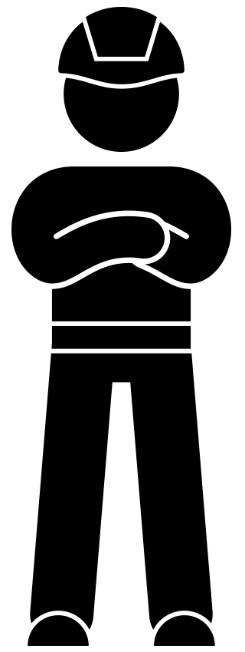
Willingness to learn One of the WAVE values
WAVE value ‘willingness to learn’ toolbox
November 2022

Slide 2
Background
In the coming years, we will be highlighting the WAVE values. The WAVE values represent the safety behaviour desired by VolkerWessels. We are convinced that if we familiarise ourselves more with the WAVE values, we can prevent accidents together.
In this toolbox we consider the WAVE value ‘willingness to learn’ - I want to learn from accidents and near misses.
Learning from each other is important in making the workplace safer. You occasionally have to deal with unsafe situations. What can you do to learn from these kinds of situations? In this toolbox we give you tips on how you can give substance to the WAVE value ‘willingness to learn’.

Slide 3
Topics
The ‘willingness to learn’ WAVE value animation
In dialogue

Slide 4
WAVE value Willingness to learn

Slide 5
In dialogue
How do you learn from incidents at the work meeting?
How did you change your routine because of an incident? What is the reason for that?

Slide 6
Thank you for your attention!
veiligheid@volkerwessels.com

