Slide 1
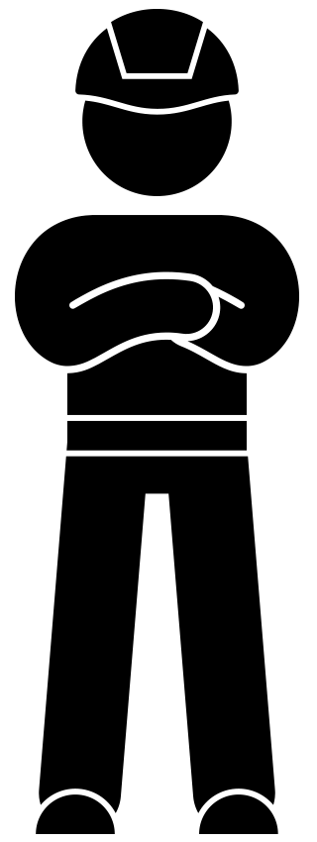
Toolbox
Working at height
February 2022

Slide 2
Background
Many incidents of falls from height happen in the construction industry. These incidents often result in serious injury or worse. Unfortunately, in 2021 this led to incidents such as a spinal cord lesion and a fatal accident at VolkerWessels.
Falling from height is number two (16%) of reports of hazardous situations (MOHS reports) within VolkerWessels. No less than 10% of sick leave is caused by falling from height. It is important to pay attention to working at height in both the preparatory and execution phases.
With this toolbox, we would like to remind you of the "do's and don'ts" in relation to the topic of working at height.

Slide 3
Topics
The animation
In dialogue

Slide 4
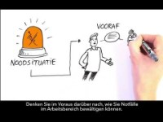
Working at height
Notes:
https://youtu.be/QbI2VhoY7cc

Slide 5
In dialogue
Have you ever experienced an accident related to working at height? What happened?
Do you ever feel unsafe while working at height? What is the reason for that?
What would you like to see different in your workplace regarding (safe) working at height?
Notes:
https://youtu.be/y0UD-hAbVok

Slide 6
Thank you for your attention!
veiligheid@volkerwessels.com

