Slide 1
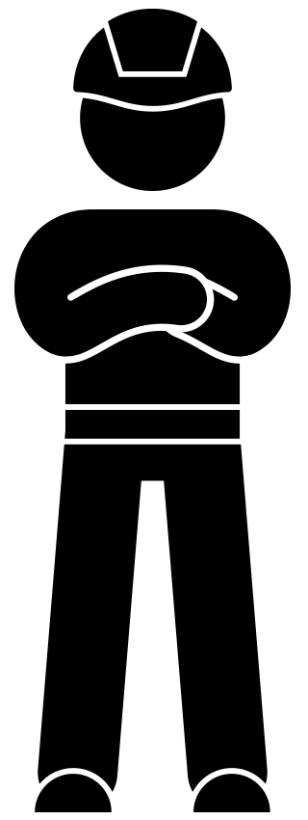
Toolbox Preventing the risk of collision October 2021

Slide 2
Background
In the construction industry, collisions in or near the workplace are still too frequent. From collisions with equipment and employees to a road user driving into the workplace. Unfortunately, this has led to the death of colleagues at VolkerWessels in the past. This has prompted VolkerWessels, together with a large number of organisations involved, to draw up a new policy to prevent collision risks. The basic principle of the new policy is that the work area and the workplace are free of personal and work traffic at the same time. The toolbox introduces you to the new policy and provides insight into how we prevent collision risks in or around the workplace.

Slide 3
Topics
The 'Collision Risk Prevention’ animation
In dialogue

Slide 4
Preventing the risk of collision

Slide 5
In dialogue
What can you do to prevent the risk of collision in the workplace?
What do you consider a collision risk in the workplace?
When was the last time you (or a colleague) had to deal with a collision risk?

Slide 6
Thank you for your attention!
veiligheid@volkerwessels.com

