Slide 1

Cutting incidents toolbox
June 2021

Slide 2
Background
Protecting your hands and fingers is important for the quality of your life and work. Cutting incidents are more common in the construction industry than you might think.
Cutting is number one (23%) in reports at VolkerWessels in 2020. No less than 16% of sick leave is caused by cutting. These are shocking statistics. Enough reason to pay extra attention to cutting incidents.
With this toolbox, we would like to remind you of the 'do's and don'ts' in relation to the topic of cutting.

Slide 3
Topics
The 'cutting incidents' animation
In dialogue

Slide 4
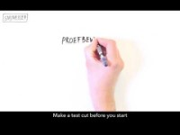
Cutting incidents
Notes:
https://youtu.be/eafcd0rIEWI

Slide 5
In dialogue
Are smaller cutting/plaster incidents preventable?
What measures do you take to cut safely?
Have you (or do you know colleagues who have) experienced cutting incidents? What was the cause?
Notes:
https://youtu.be/y0UD-hAbVok

Slide 6
Thank you for your attention!
veiligheid@volkerwessels.com

