Slide 1
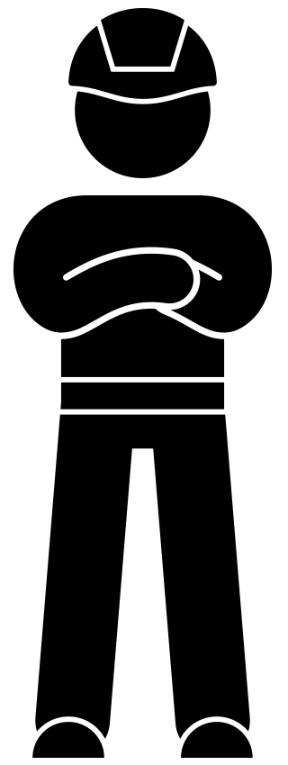
Responsible One of the WAVE values
'Responsible' WAVE value toolbox

Slide 2
Background
In the coming years, we will be highlighting the WAVE values. The WAVE values represent the safety behaviour desired by VolkerWessels. We are convinced that if we familiarise ourselves more with the WAVE values, we can prevent accidents together.
This toolbox addresses the WAVE value: Responsible. Being responsible for your own safety and the safety of your colleagues calls for leadership.
The toolbox encourages you to think about how you can take responsibility.

Slide 3
Topics
The 'responsible' WAVE value animation
In dialogue
How do you take responsibility?

Slide 4
'Responsible' WAVE value

Slide 5
In dialogue
What does taking responsibility mean to you?
Where does your responsibility stop?
When was the last time you took responsibility for safety? Why did you do that?
Notes:
https://youtu.be/y0UD-hAbVok

Slide 6
How do you take responsibility?
Watch the video in which colleagues explain how they take responsibility.
Think of one action you can take to take responsibility this week. Share this with the group.

Slide 7
Thank you for your attention!
veiligheid@volkerwessels.com

