Slide 1
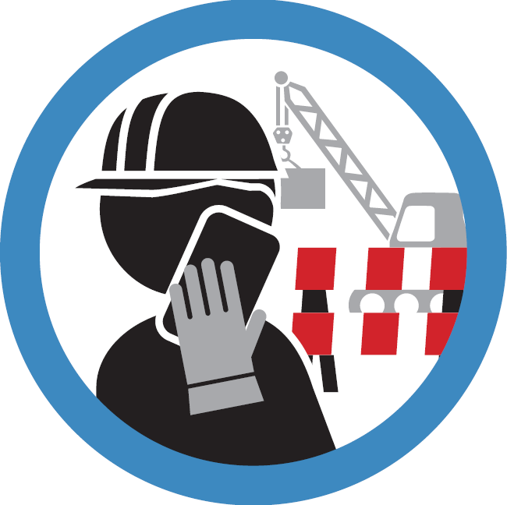
Use mobile devices in a safe place The 8th WAVE safety rule

Slide 2
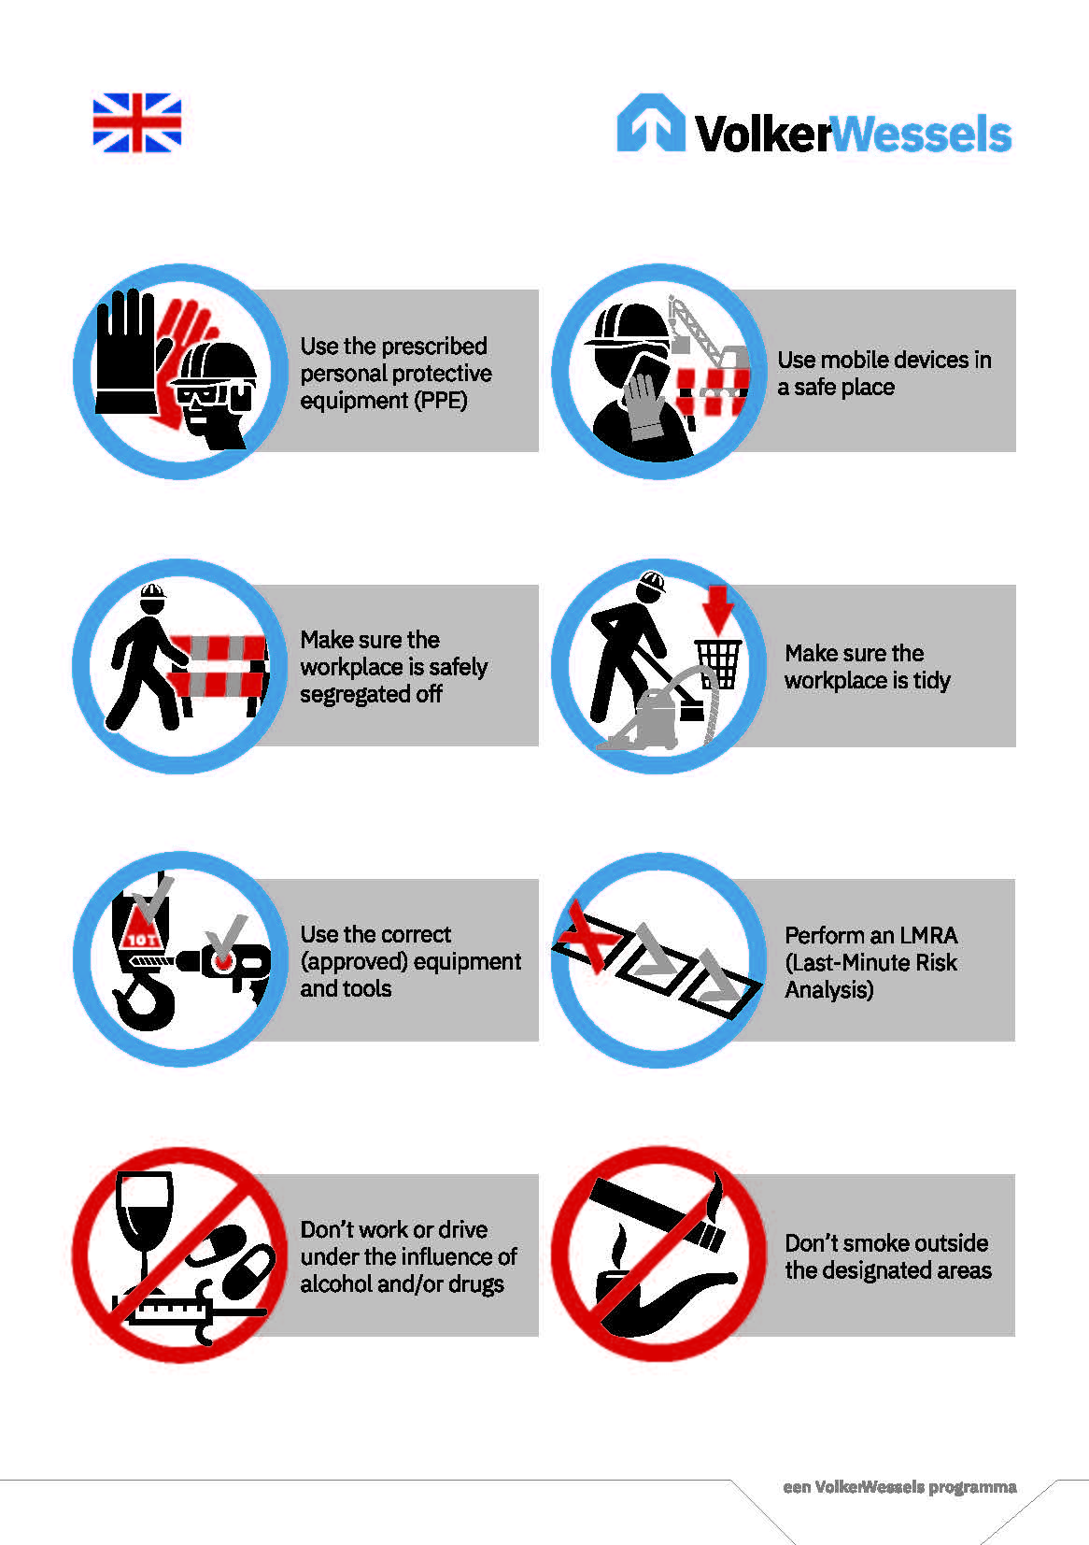
Background
Our WAVE values and safety rules make sure we all go home safe at the end of the day. Mobile devices have become an essential feature of everyday life. Whether for work-related or private matters, or to stay in touch with our loved ones, we are all contactable for much of the day. In our operational workplaces, that’s useful for quickly arranging things in between working, but it can also create risks when combined with our daily work activities.
This toolbox explains why VolkerWessels is introducing an 8th safety rule and how you can safely use a mobile device in an operational workplace.

Slide 3
Use of mobile devices

Slide 4
Risks > What can go wrong?
You get distracted by using the device (messaging, e-mailing, online meeting, phoning, etc.) and as a result you are not fully focused on your own safety and the safety of those around you.
Dangerous situations can arise, for example in the vicinity of equipment, heavy objects or local traffic.
You can unintentionally end up in the danger zone of vehicles.
If you call an employee working in operations, he/she may be distracted by the call.
In recent years, the use of mobile devices has contributed to fatal accidents at VolkerWessels.

Slide 5
Risks > at VolkerWessels
< PLACEHOLDER: place supporting material for your company here. That could be photos showing the use of mobile devices leading to an unsafe situations or, for example, relevant MOHS reports from the WAVE app. >

Slide 6
Measures > what should you do? When preparing work activities
When preparing work activities, designate one or more locations where mobile devices can be safely used.
Segregate those locations off visibly and safely.
Inform those in the operational workplace about the safe use of mobile devices at the location and where they are permitted to safely use a mobile device.

Slide 7
Measures > what should you do? In operational workplaces
Call from a safe place.
Stand still when making a phone call to avoid falling or stumbling.
Keep the use of the device (for example the call) short! If the conversation takes a little longer, or if it is a difficult conversation, preferably park the car or machine or call back later.
Use the mobile devices only for business purposes (for example for requesting equipment, reporting faults or incidents and accidents using the WAVE app).
Conduct private conversations during scheduled rest and break times.
It is prohibited to have your smartphone in your hand whilst driving and/or operating a car or machine!
It is prohibited to have the screen switched on during a video call while operating the car or machine. If it is a difficult conversation, consider parking the car.

Slide 8
What is a safe place?
Mobile devices should be used in a safe place. A safe place is:
The place designated by the project or the supervisor and if possible marked off as a safe place.
Outside the route of work traffic or local traffic.
At least 4 metres from edges, holes and recesses in connection with the risk of falling.
Away from loads being hoisted or lifted and outside the turning radius of machines.
In an explosion-safe area (hazardous materials).
Where you are clearly visible to your colleagues.

Slide 9
Talking to each other
Do you get distracted by mobile devices in the workplace?
What can you do in this workplace to work (more) safely with mobile devices?

Slide 10
Thank you for your attention!
veiligheid@volkerwessels.com
https://www.volkerwessels.com/nl/downloadpagina-veiligheid

Slide 11
Additional questions for discussion
Additional questions for the toolbox. The questions can be used at your discretion.
Who has ever reported a situation involving a mobile device?
Are you always safe when you are on the phone?
How often do you use your phone in the car? And why?
What can you do in order to use a mobile device safely when in the operational workplace?
Where is the designated location to safely use a mobile device in this workplace?
Who has the WAVE app on their phone? What was the last report you made about?

