Slide 1
Safety leaders at work
Recognising a hazard and accepting risks

Slide 2
Background
At VolkerWessels, everyone is a safety leader. Every colleague applies WAVE and actively contributes to our safety culture. We learn from each other and challenge each other to do it right. Together we keep our workplace safe, whatever your role in our work.
Going home safe every day; that starts with recognising hazards and being aware of potential risks you are taking, or choose not to take.
Watch the video, join the discussion and work more safely – every day!

Slide 3
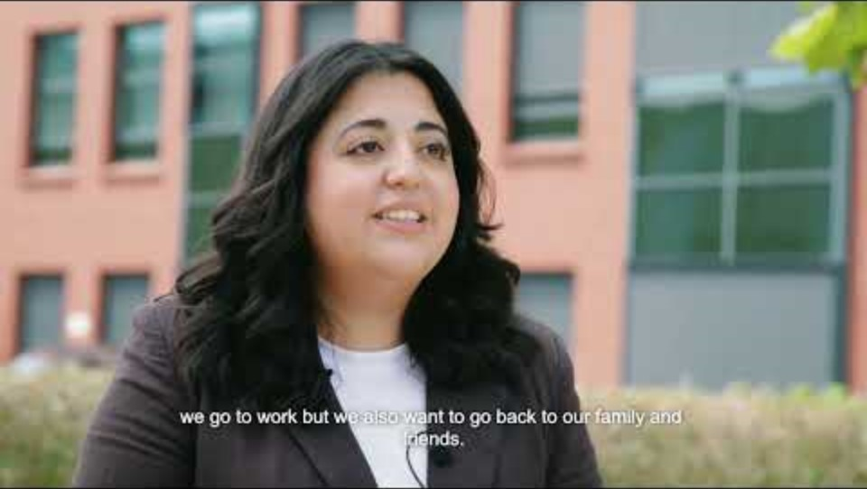
How do our safety leaders do that?

Slide 4
How do our safety leaders do that?
What are these safety leaders doing right?
Which hazard in this workplace should you be taking extra measures for?

Slide 5
What can you do yourself?
Recognising a hazard!
Tip: Talk to your team about hazards in order to consciously work safely together. That way you stay on your toes, even if the work changes.
Question: How do you bring (new or existing) colleagues up to speed on the most important hazards in your work?
Perhaps you have got used to a risk...
Tip: You can become blind to a risk because ‘it has never been a problem before’. Precisely for that reason, you need to pay extra attention and take the time to check whether the situation is still truly safe. For example, by consistently performing the LMRA (Last Minute Risk Analysis) .
Question: Do you sometimes take the time to check whether you are still working safely?

Slide 6
Talking to each other
What hazard do you know a lot about?
What is the most significant risk in this workplace? Why?

Slide 7
Thank you for your attention!
Questions or comments?
veiligheid@volkerwessels.com
https://www.volkerwessels.com/nl/downloadpagina-veiligheid

Slide 8
Additional questions for discussion
Additional questions for the toolbox meeting. You can use the questions as you see fit.
How do you stay alert to hazards?
Do you have an example of a situation that turned out to be dangerous and ended badly?
How do you teach children to deal with dangerous situations?
What risks do you sometimes take at home or when driving?
What risk keeps you awake at night?
What risk do you believe should receive more attention?

