Slide 1




Slide 2


Slide 3
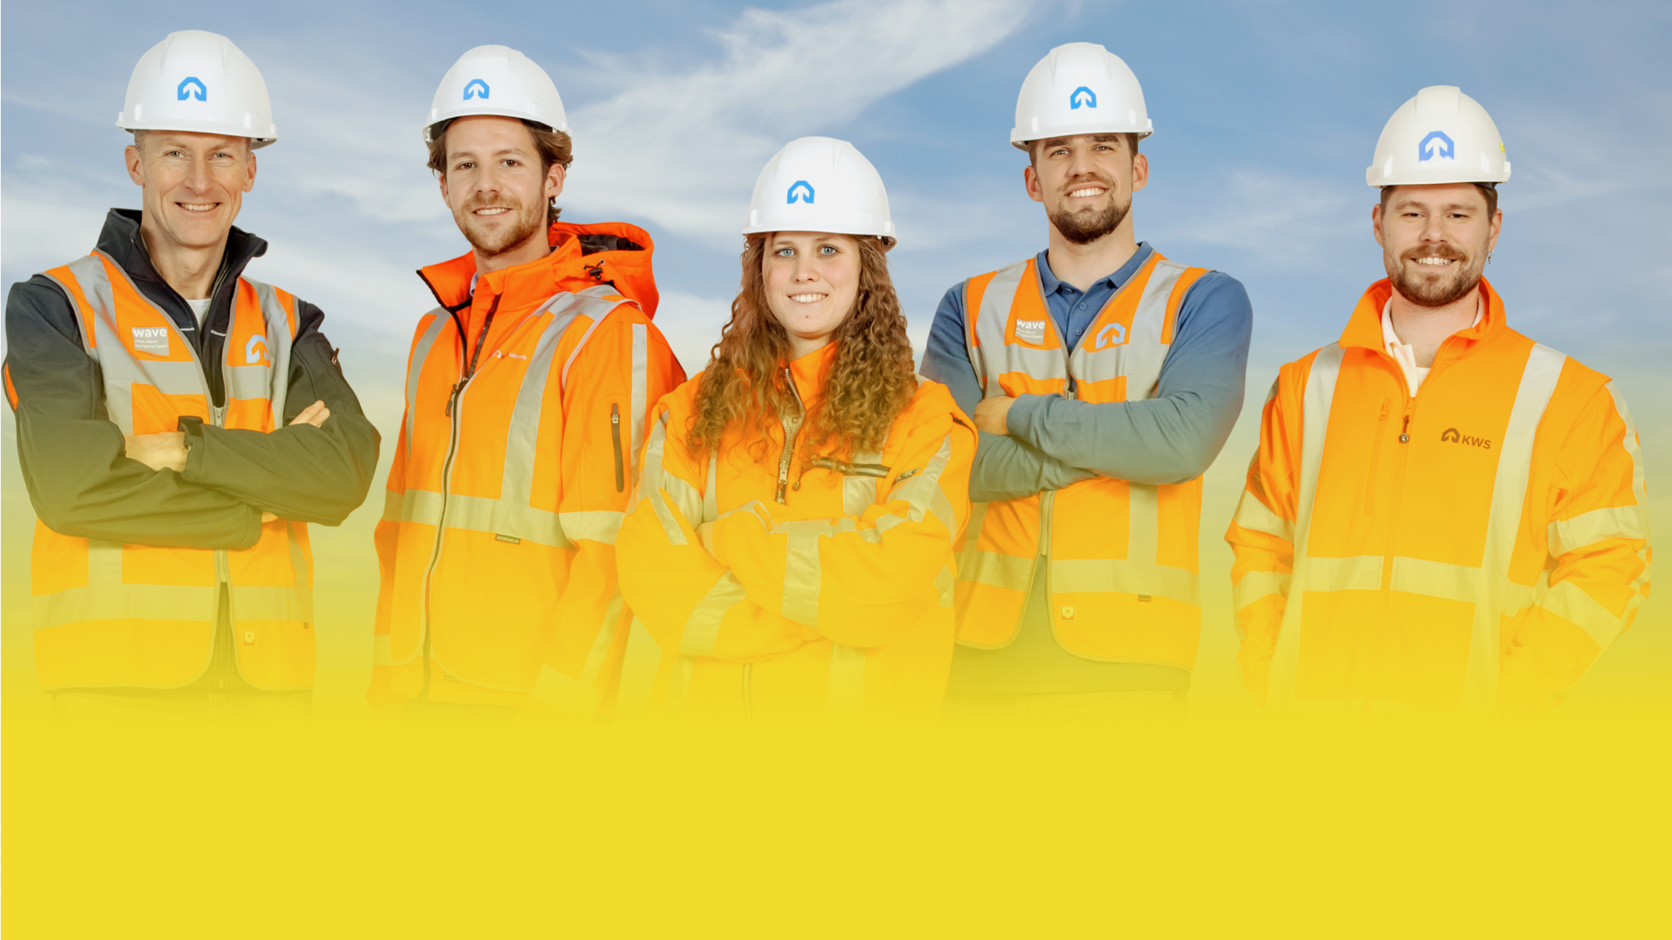

From bingo! An accident, to:
WORKING SAFELY TOGETHER, YOU CAN MAKE THE DIFFERENCE
Bingo! Now I can make the difference

Slide 4
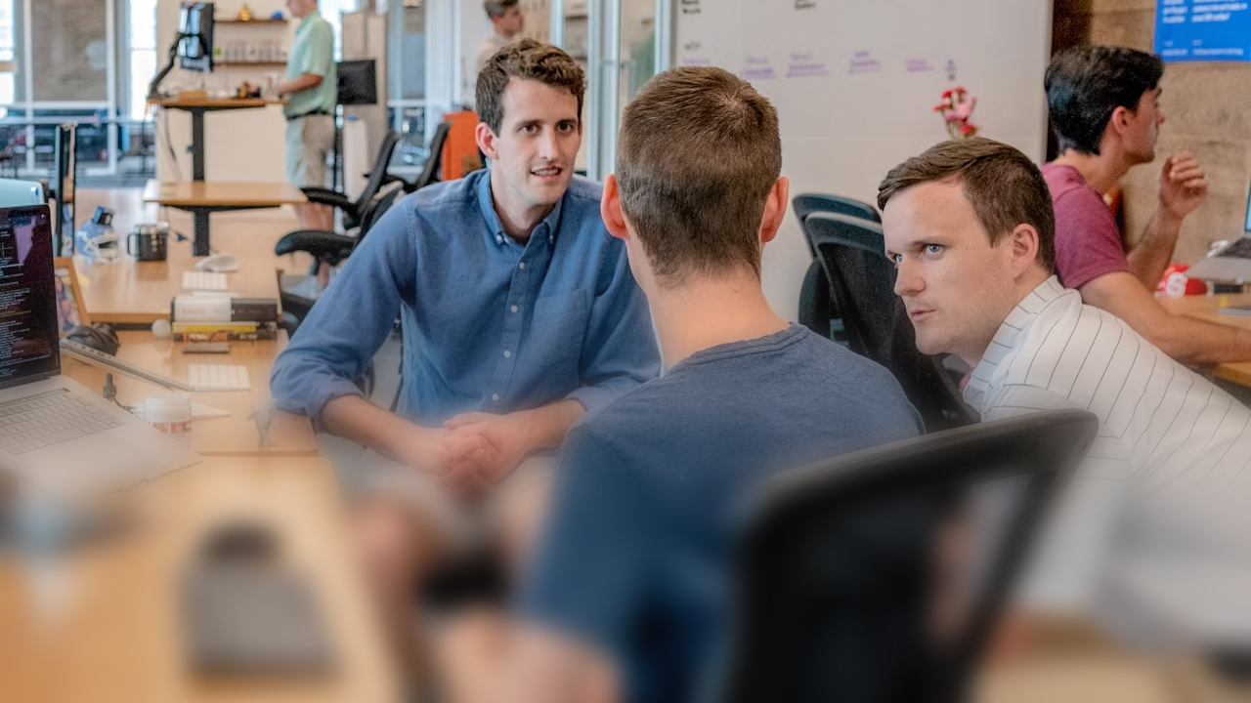



WAVE value: Respect

Slide 5
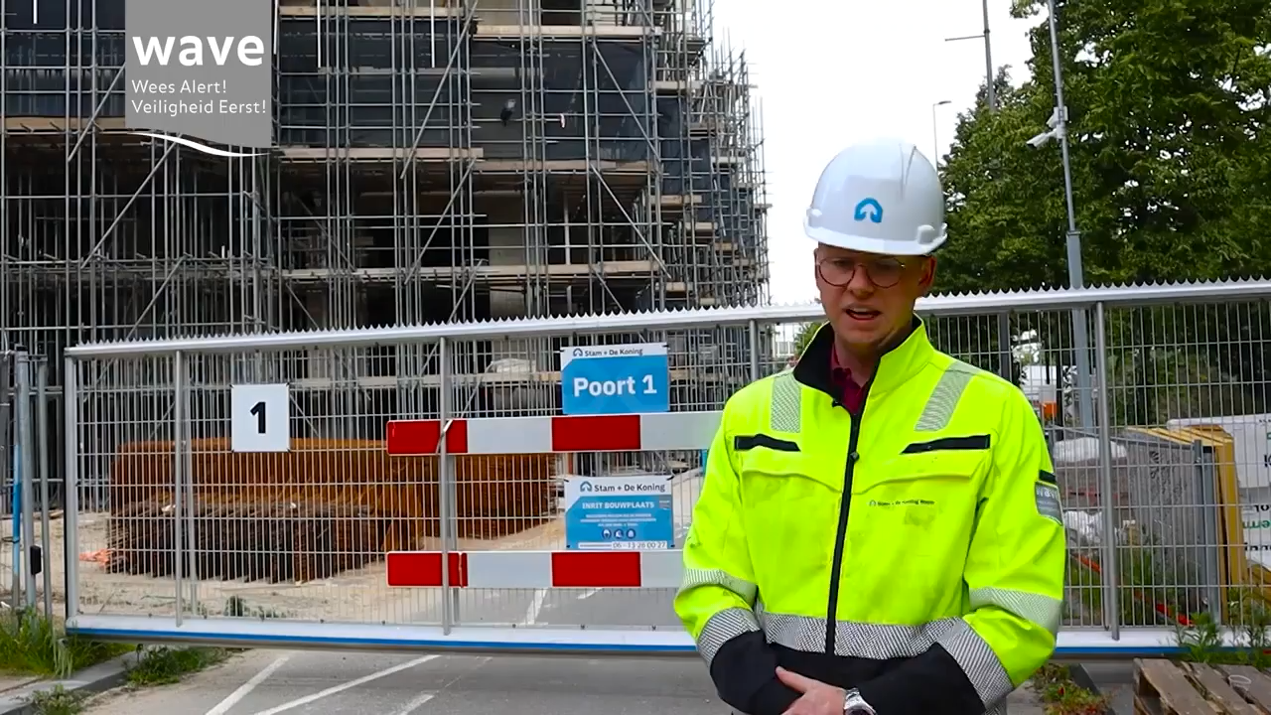

Slide 6
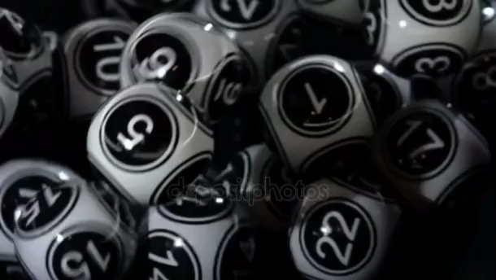

Get your
bingo card ready!

Slide 7


12

Slide 8


How would you like others to challenge your unsafe behaviour?
Please explain or show what you mean.
Question
WAVE value: Respect

Slide 9
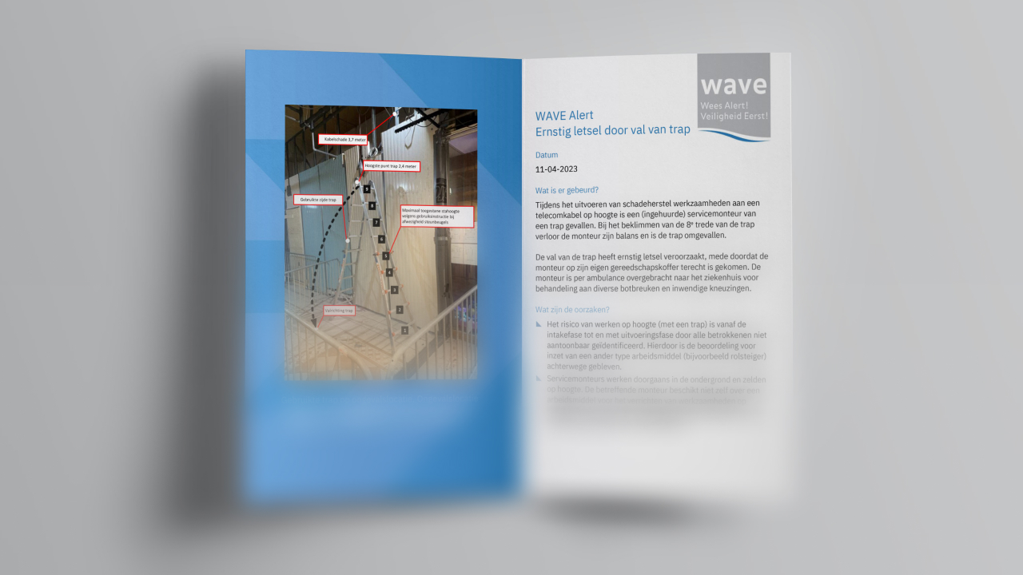
WAVE value: Willingness to learn

Slide 10
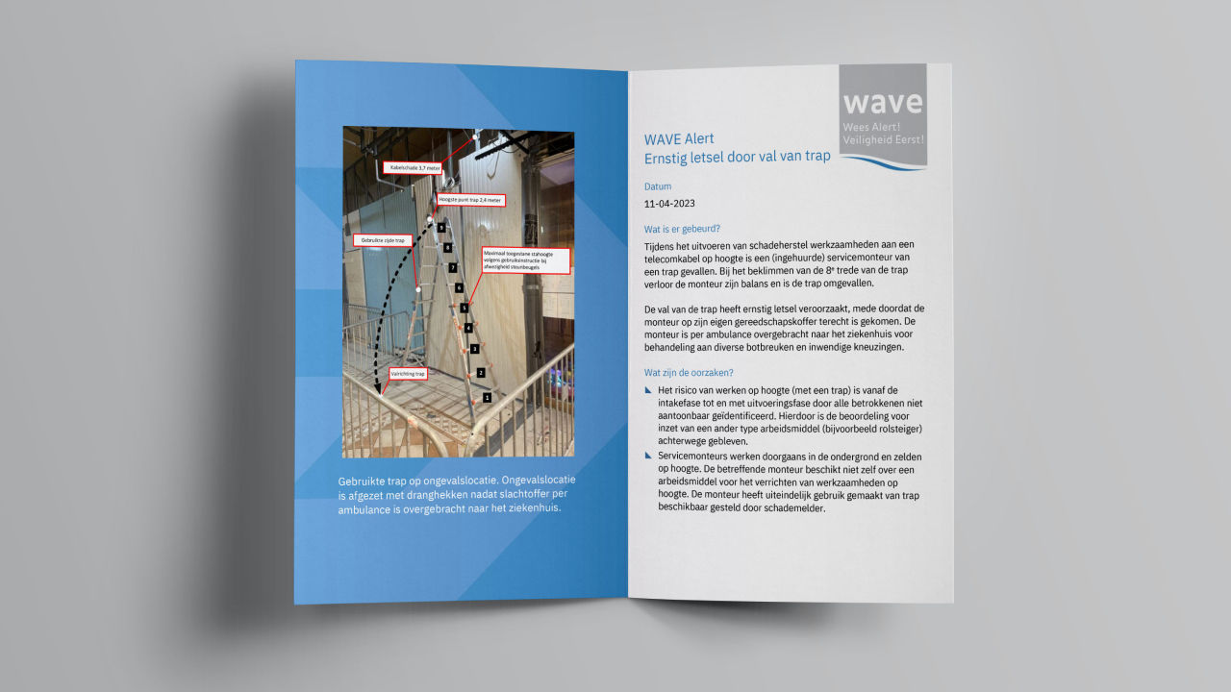

Slide 11
Get your
bingo card ready!

Slide 12
4

Slide 13
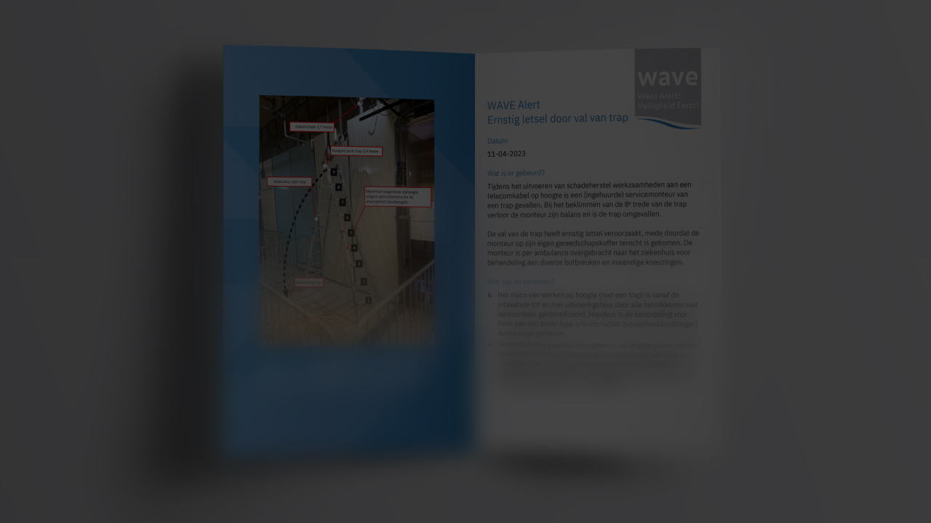
That was close! You could just step out of the way and avoid an accident. You also know exactly what you could have done differently to make this work safe or safer from now on. Your colleagues didn't see or hear anything.
Dilemma
WAVE value: Willingness to learn

Slide 14

WAVE value: Consistent

Slide 15
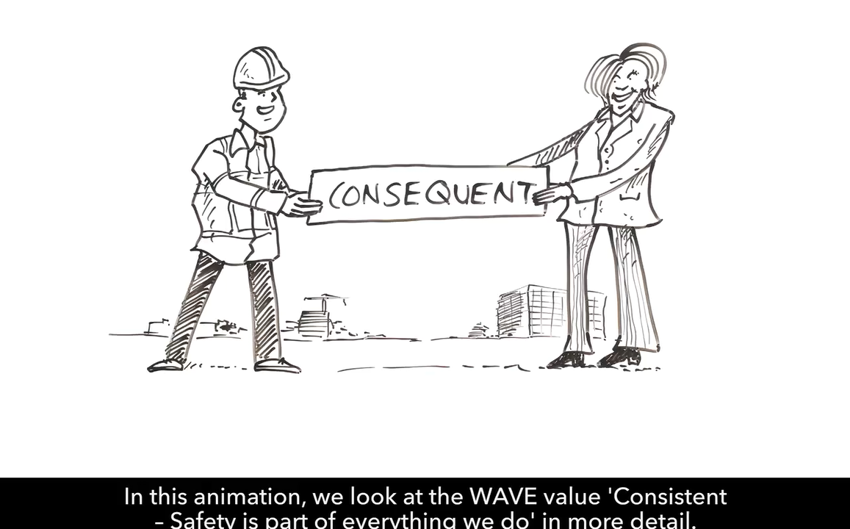

Slide 16
Get your
bingo card ready!

Slide 17
6

Slide 18

Just before the end of the work, the excavator breaks down. The excavator is an important piece of equipment for finishing the work on time. Repairs will take a few days and timely delivery is jeopardised.
Who has ever experienced a similar situation and what did you do?
Dilemma
WAVE value: Consistent

Slide 19

WAVE value: Action

Slide 20
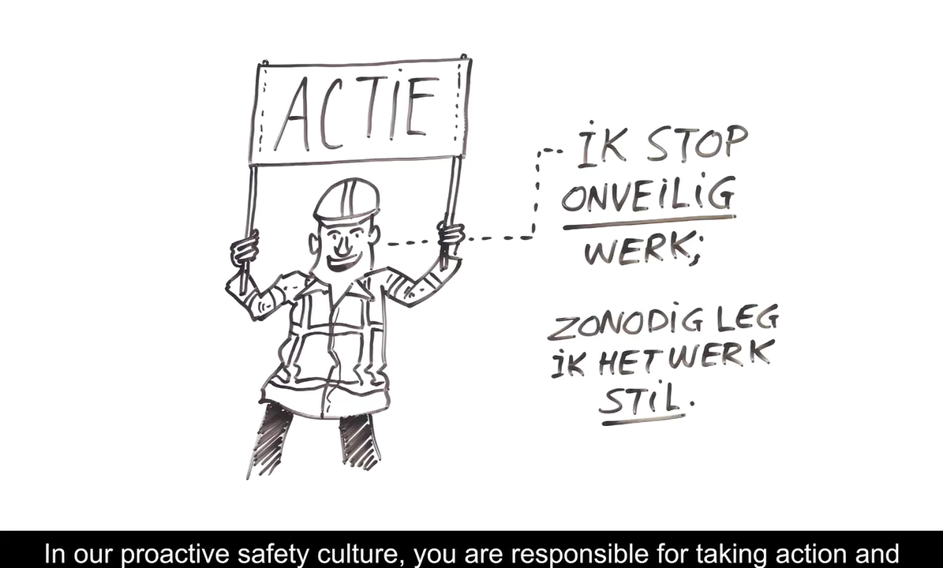

Slide 21
Get your
bingo card ready!

Slide 22
21

Slide 23

Have you ever walked past a situation (work and/or private) where afterwards you thought: "I should have said something about this"?
Question
WAVE value: Action

Slide 24
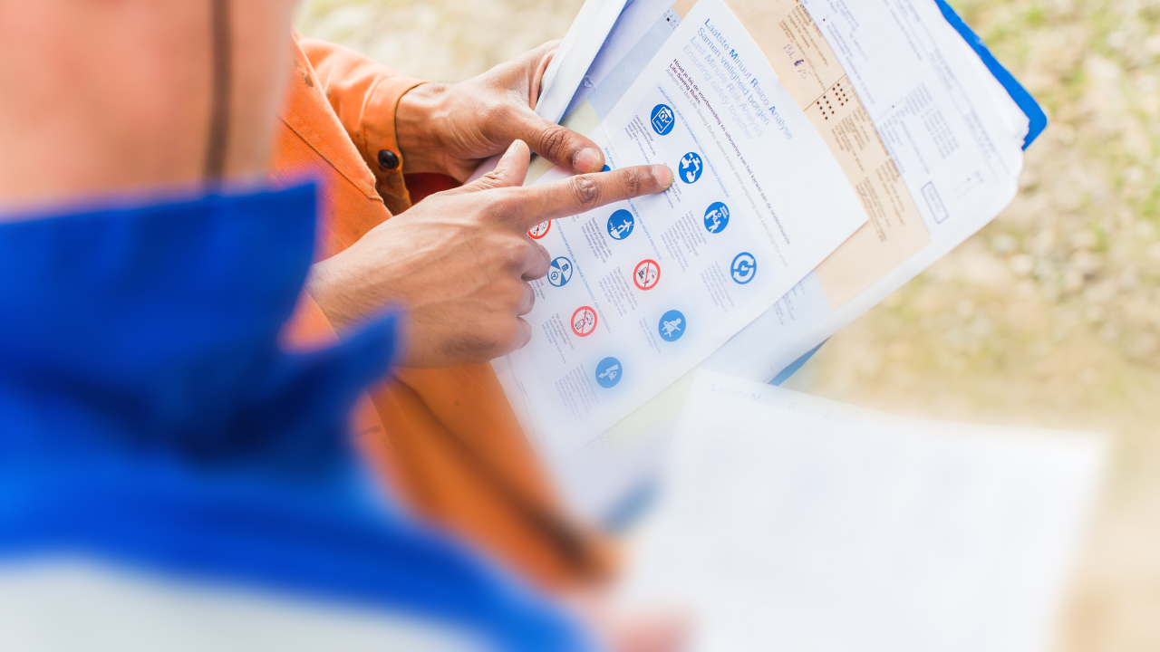
WAVE value: Responsible

Slide 25
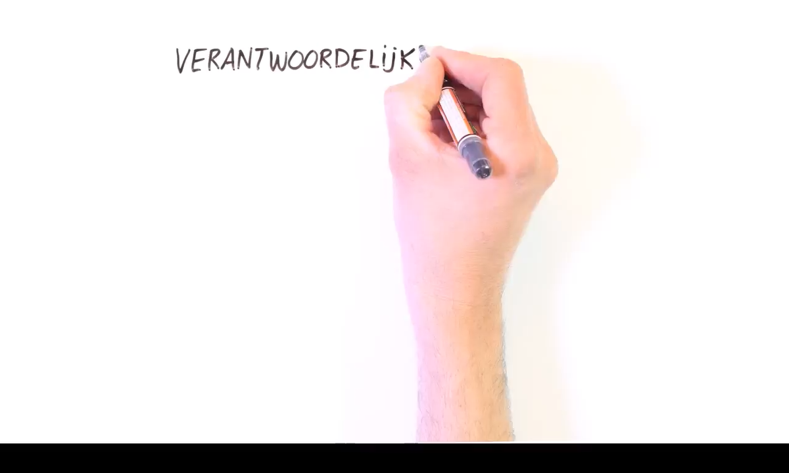

Slide 26
Get your
bingo card ready!

Slide 27
28

Slide 28

It is the end of the work day and you have cleared away and tidied up everything. You are ready to go home.Some distance away, you see an excavator closing a trench. Another colleague is already starting to remove the barrier, which means that pedestrians could enter the turning circle of the excavator.
What do you do?
Dilemma
WAVE value: Responsible

Slide 29

WAVE value: Fair

Slide 30
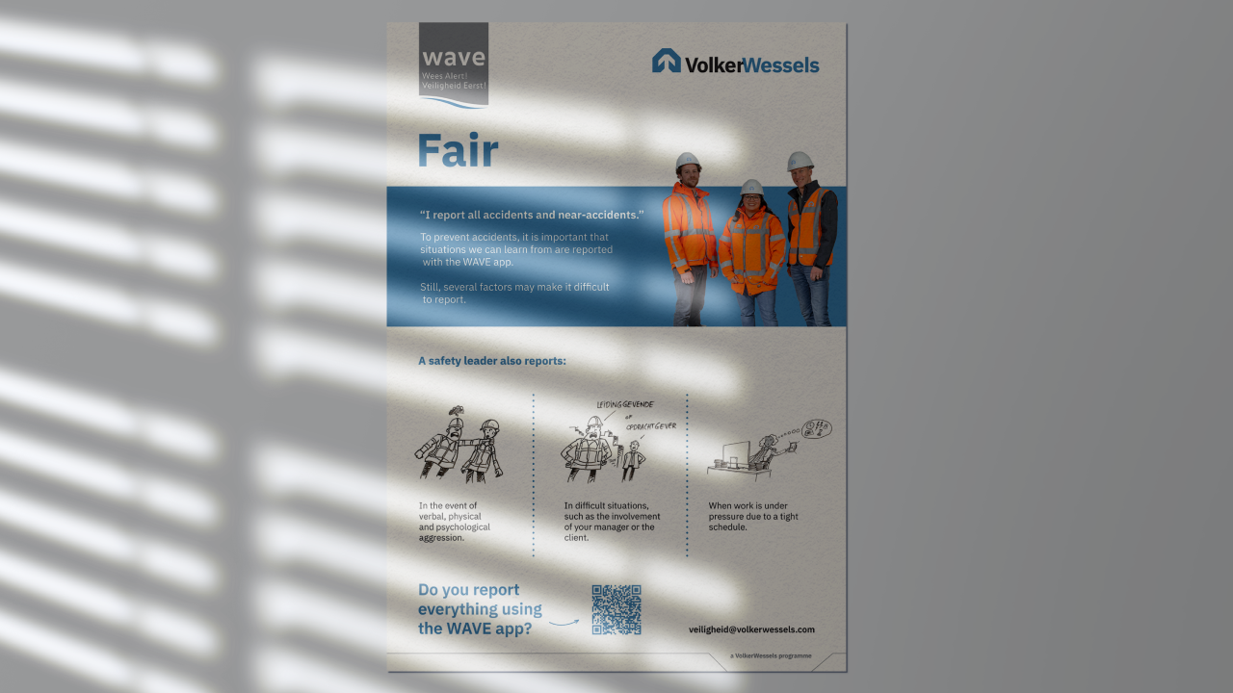

Slide 31
Get your
bingo card ready!

Slide 32
33

Slide 33
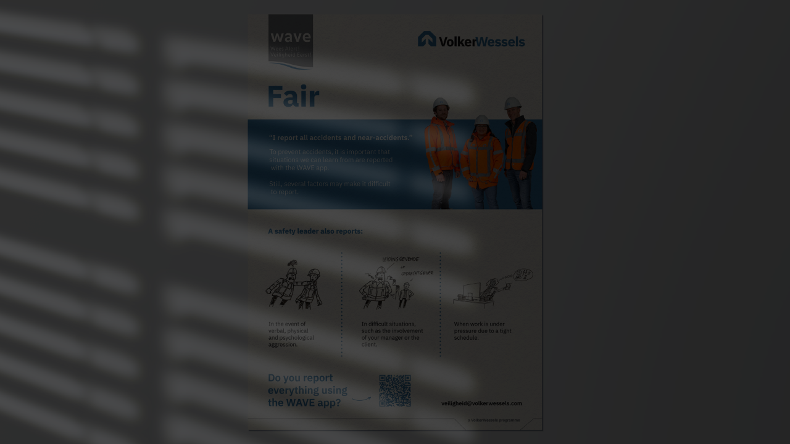
During which situations would you consider whether or not to report something using the WAVE app so as not to harm yourself or others?
Please explain your answer.
Dilemma
WAVE value: Fair

Slide 34
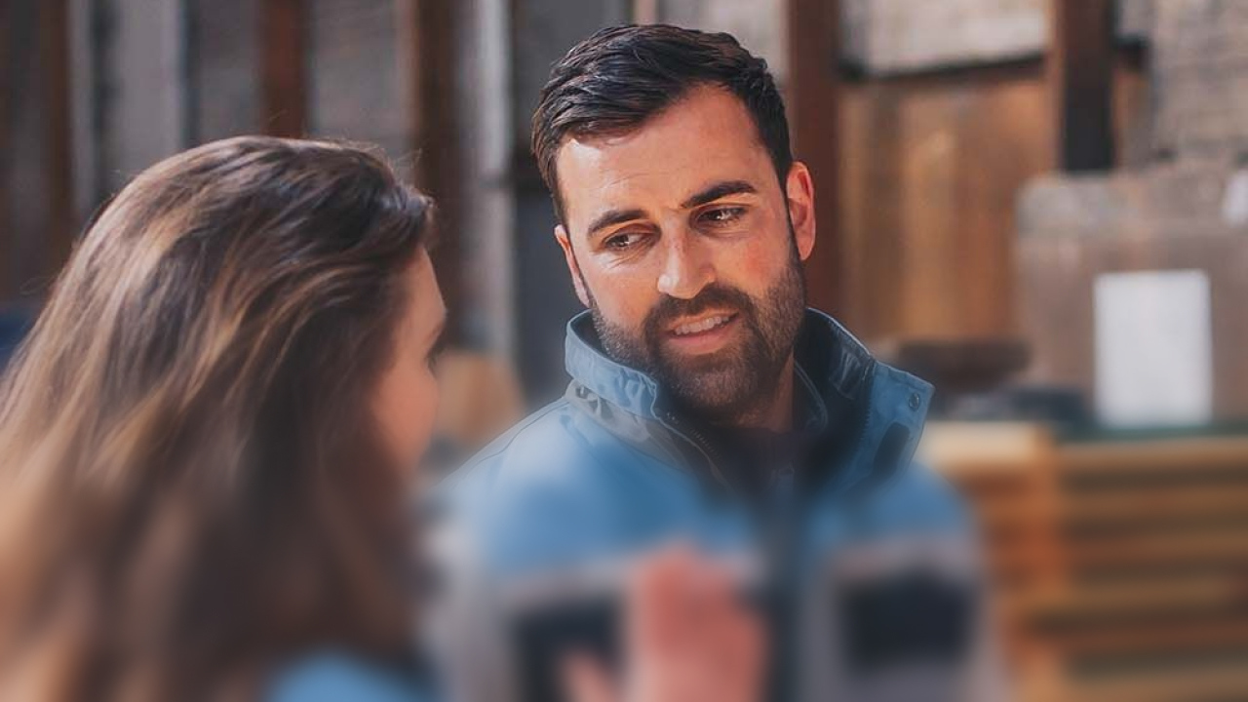
WAVE value: Open

Slide 35
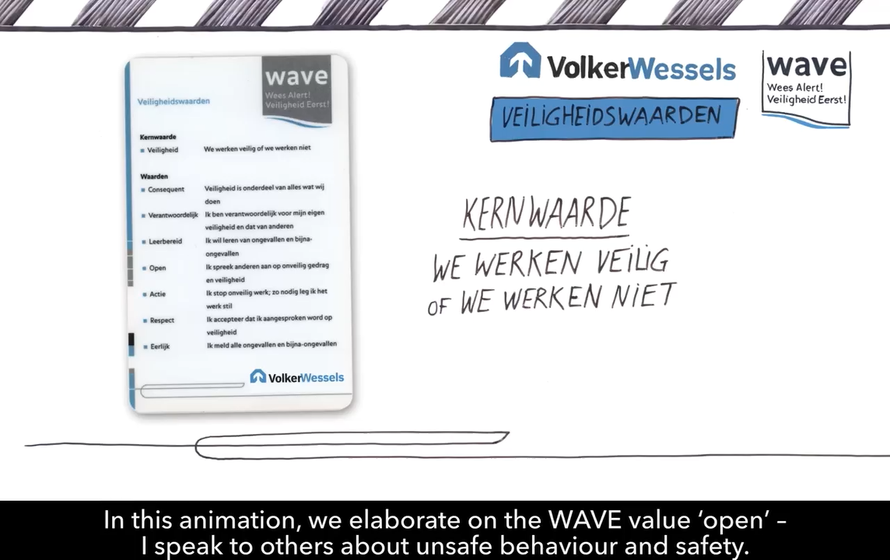

Slide 36
Get your
bingo card ready!

Slide 37
48

Slide 38
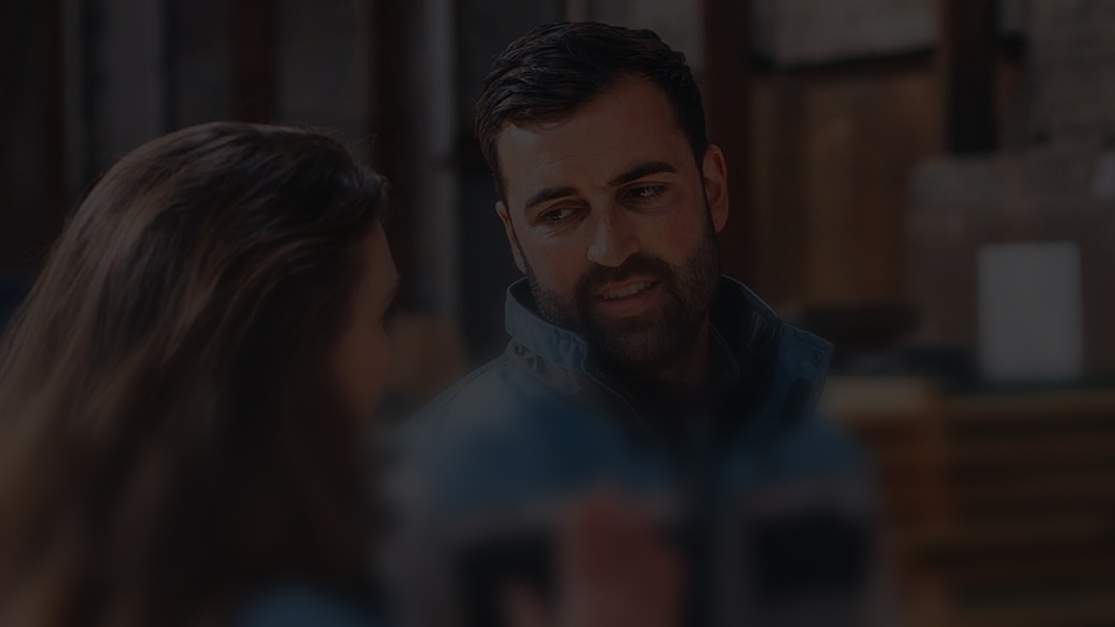
Are there situations where you do not challenge a colleague's behaviour?
What is the reason for that?
Question
WAVE value: Open

Slide 39
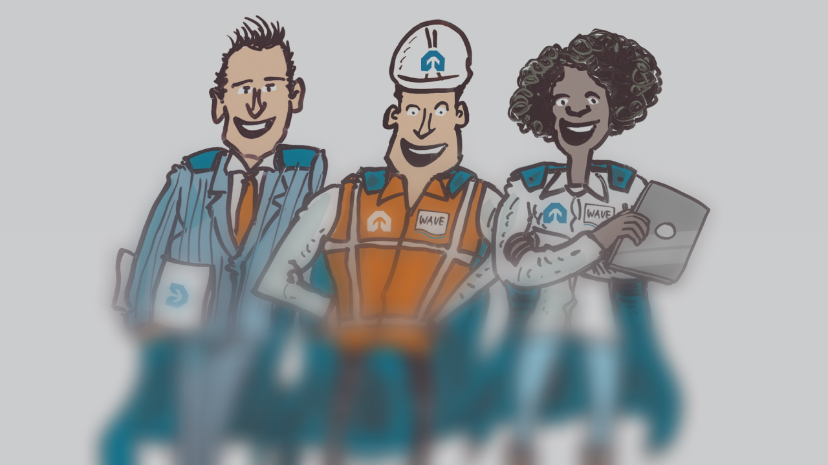
Safest colleague

Slide 40
Get your
bingo card ready!

Slide 41
10

Slide 42
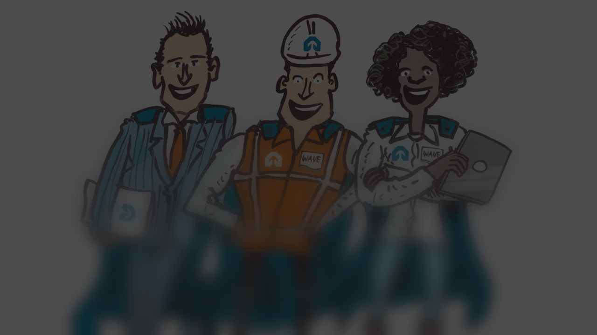
Who do you nominate for a Safe Working Compliment?
Please explain your answer.
By the way: Have you already awarded this colleague a Compliment in the WAVE app?
Question
Safest colleague

Slide 43
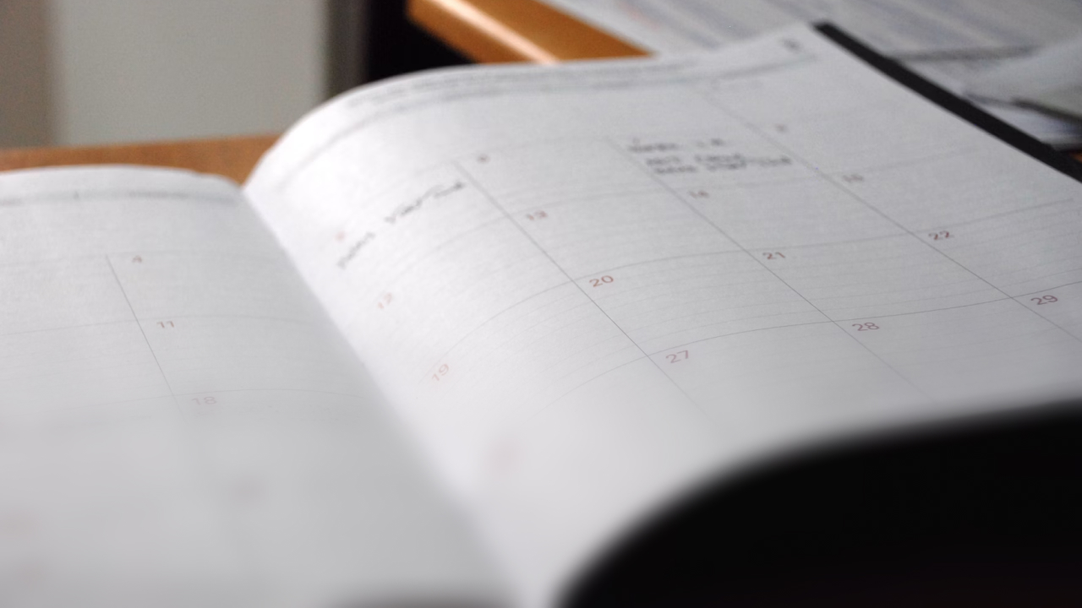
Overestimating your abilities?!

Slide 44
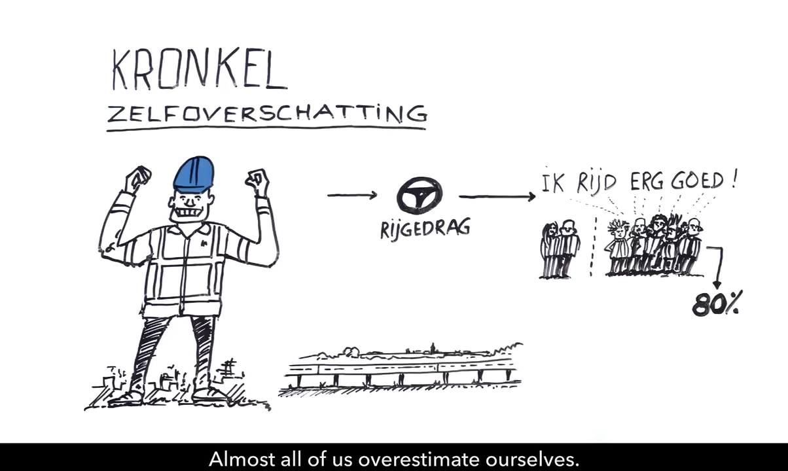

Slide 45
Get your
bingo card ready!

Slide 46
56

Slide 47
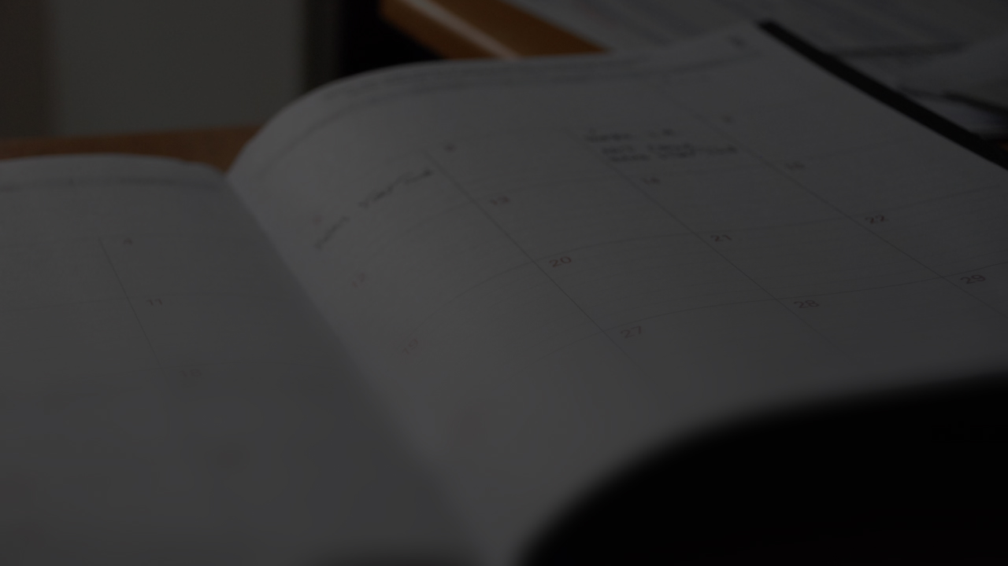
The most common form of overestimation is planning. Do you agree or disagree? What risk does this entail?
Do you ever overestimate your abilities?
Dilemma
Overestimating your abilities?!

Slide 48
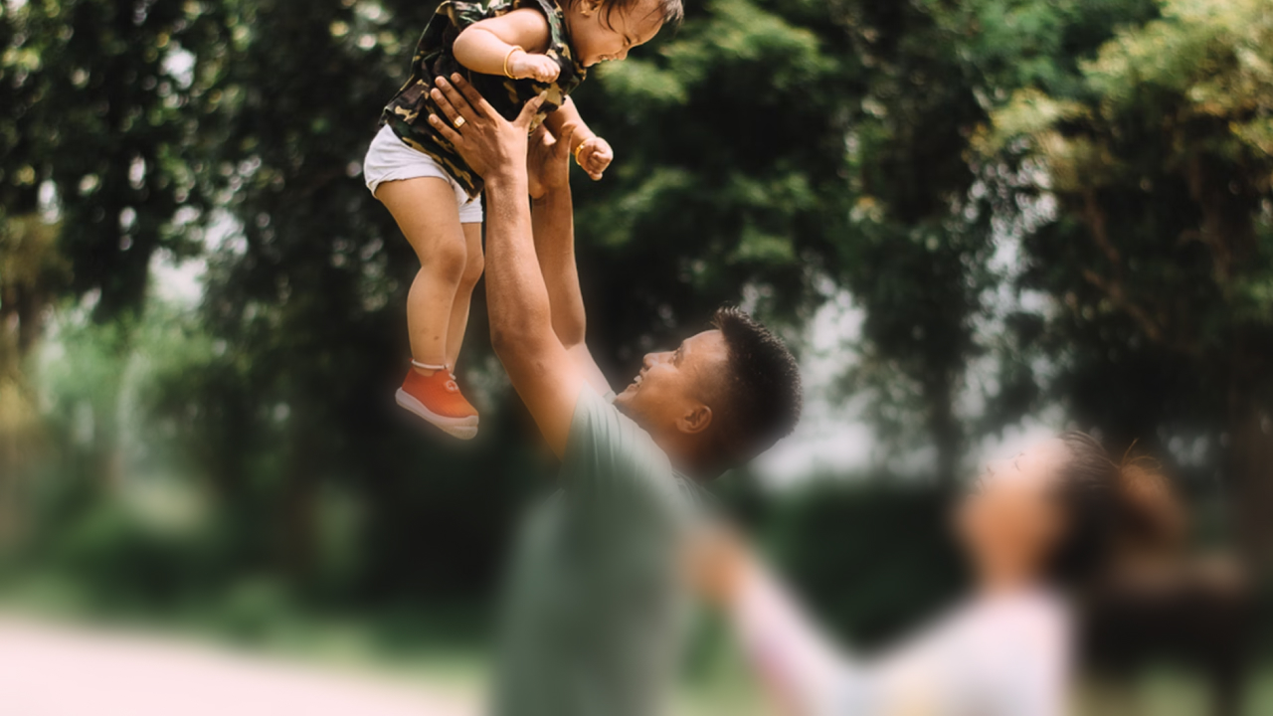
What's in it for you?

Slide 49
Get your
bingo card ready!

Slide 50
3

Slide 51
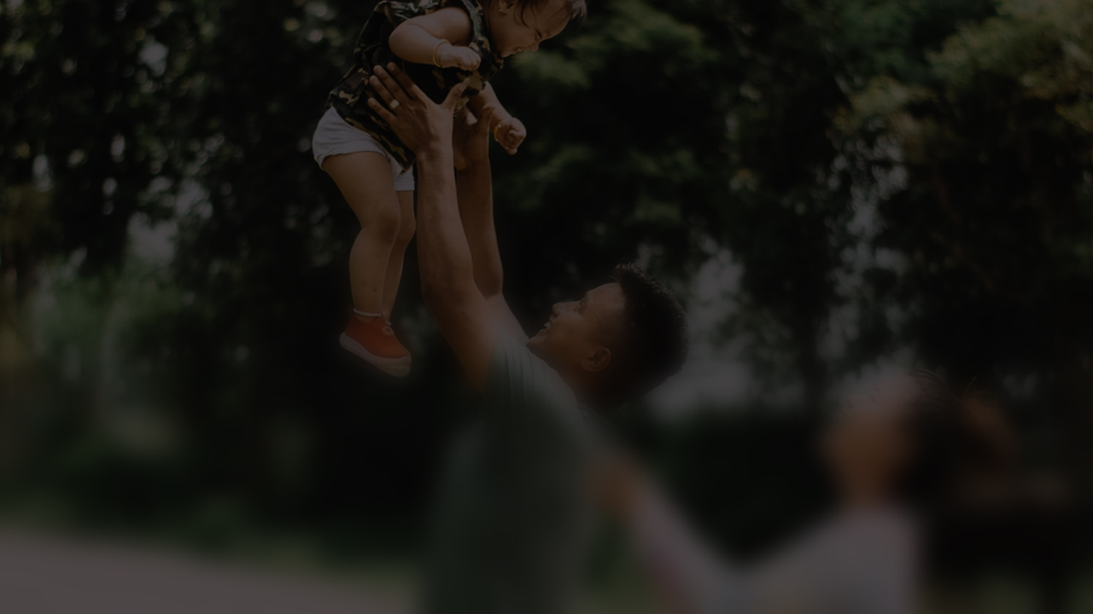
Who or what is your personal motivation for working safely yourself and enabling others to work safely?
Dilemma
What's in it for you?

Slide 52
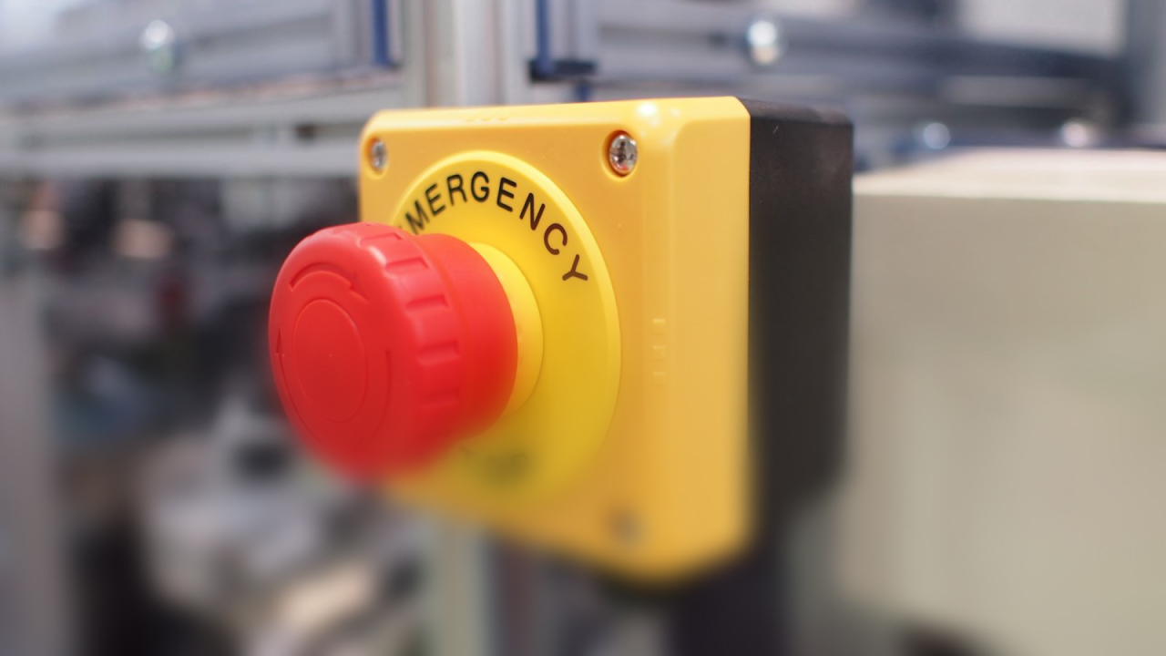
Warning sign

Slide 53
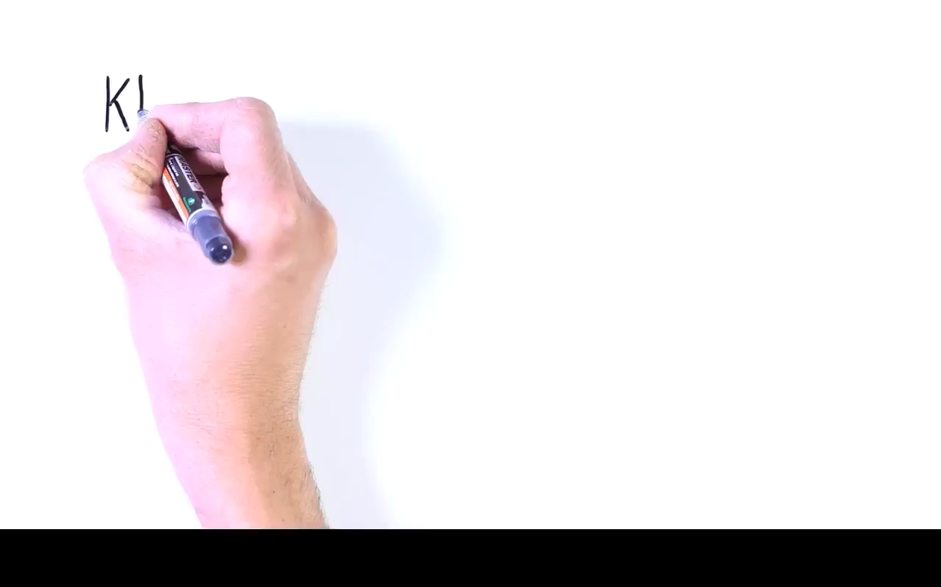

Slide 54
Get your
bingo card ready!

Slide 55
11

Slide 56
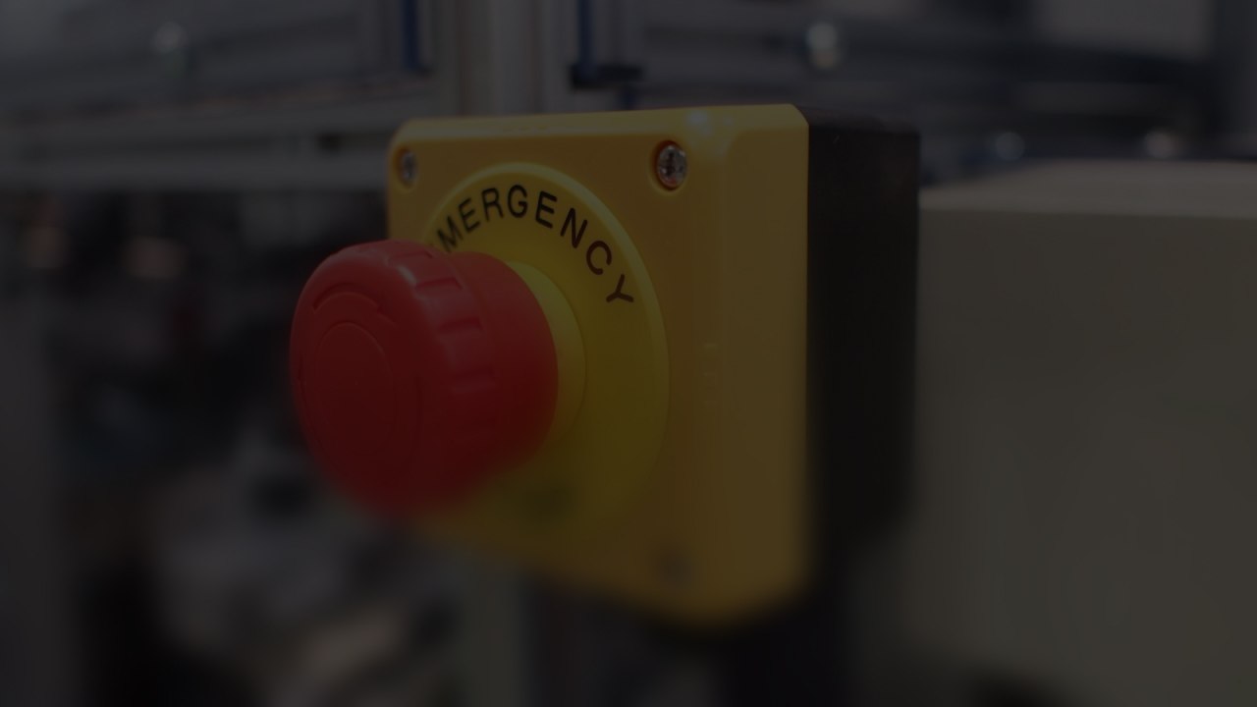
When was the last time you had any doubts as to whether the work could be carried out safely?
Why? And what did you do?
Dilemma
Warning sign

Slide 57
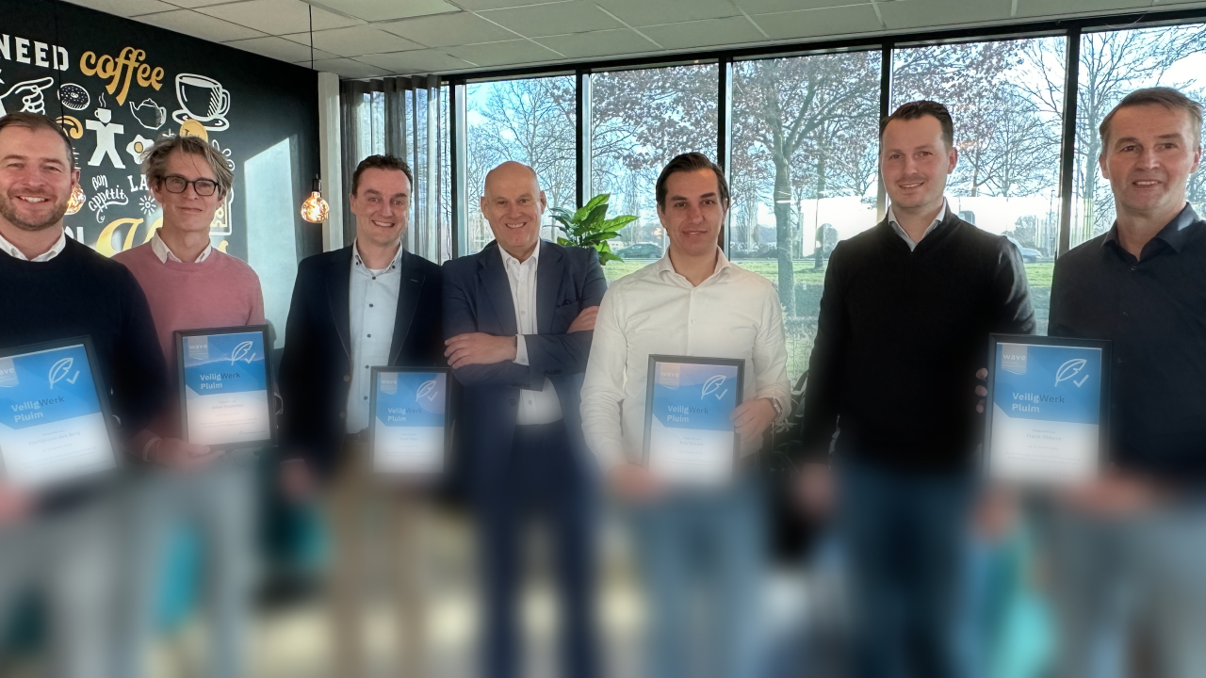
The difference

Slide 58
Get your
bingo card ready!

Slide 59
20

Slide 60

Do you have the feeling that you can make a difference in terms of safety within this organisation?
Please explain your answer.
If not, what do you think will have to change?
Question
The difference

Slide 61


Slide 62
