Slide 3
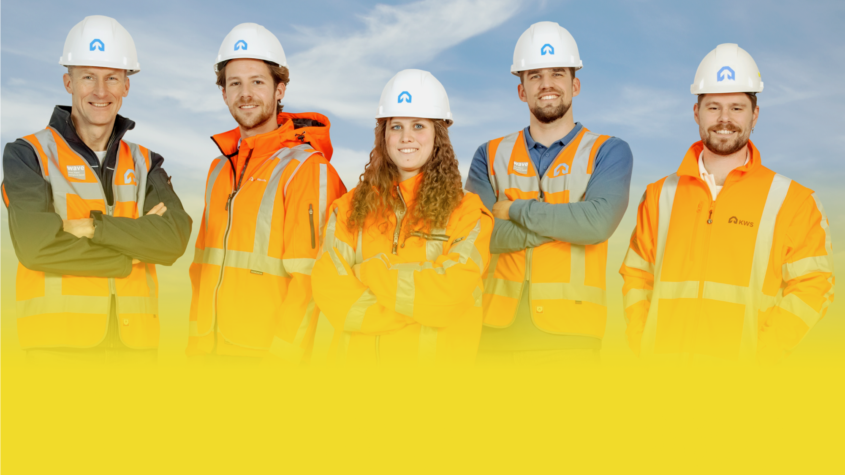
From bingo! An accident, to:
WORKING SAFELY TOGETHER, YOU CAN MAKE THE DIFFERENCE
Bingo! Now I can make the difference

Slide 4
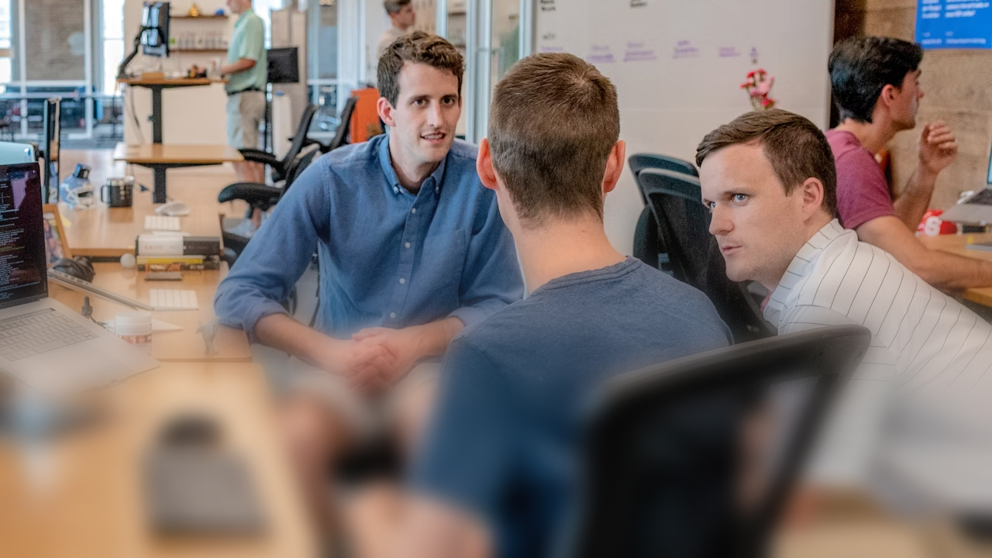
WAVE value: Respect

Slide 6
Get your
bingo card ready!

Slide 7
12

Slide 8
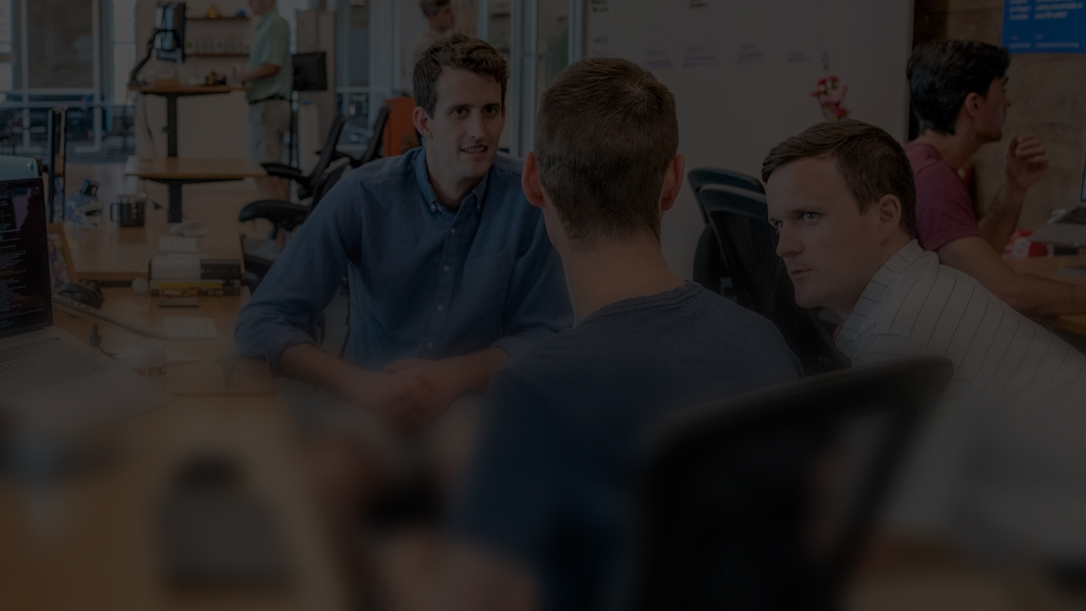
During an alcohol-free after-work drink, a colleague speaks in a derogatory tone about the looks of another colleague who is not there at the time. What do you do?
Question
WAVE value: Respect

Slide 9
WAVE value: Willingness to learn

Slide 11
Get your
bingo card ready!

Slide 12
4

Slide 13
How would you like to learn from a WAVE report? Can you give an example of a report from which you learned a lesson?
Question
WAVE value: Willingness to learn

Slide 14
WAVE value: Consistent

Slide 16
Get your
bingo card ready!

Slide 17
6

Slide 18
Safety is part of everything we do. What have you done lately to improve safety, and what more could you have done?
Question
WAVE value: Consistent

Slide 19
WAVE value: Action

Slide 21
Get your
bingo card ready!

Slide 22
21

Slide 23
During a risk session in the design phase, you have the feeling that one of the risks is not being taken seriously. You seem to be the only one who gives the risk serious consideration. You mention that you have the feeling that it is not being taken seriously, but the group still does not recognise the danger. You remember from a previous project that this resulted in a serious accident.
What do you do?
Dilemma
WAVE value: Action

Slide 24
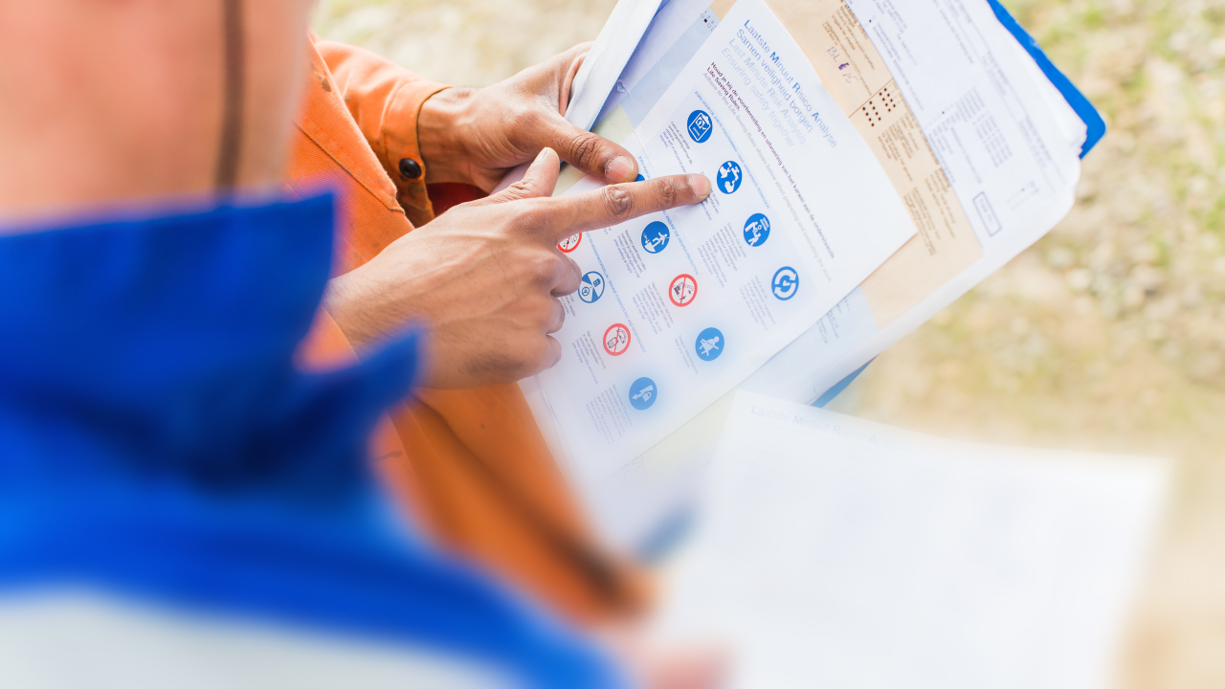
WAVE value: Responsible

Slide 26
Get your
bingo card ready!

Slide 27
28

Slide 28
Have you ever done something to make a situation safer?
If so, what did you do?
Question
WAVE value: Responsible

Slide 29
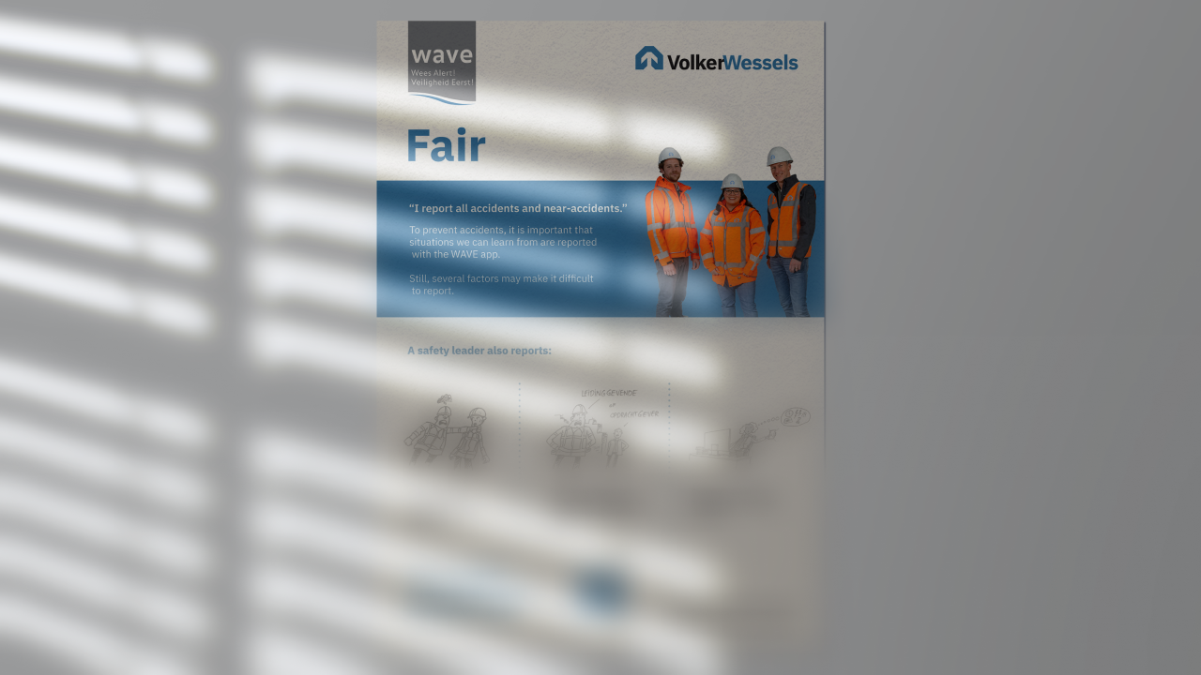
WAVE value: Fair

Slide 31
Get your
bingo card ready!

Slide 32
33

Slide 33
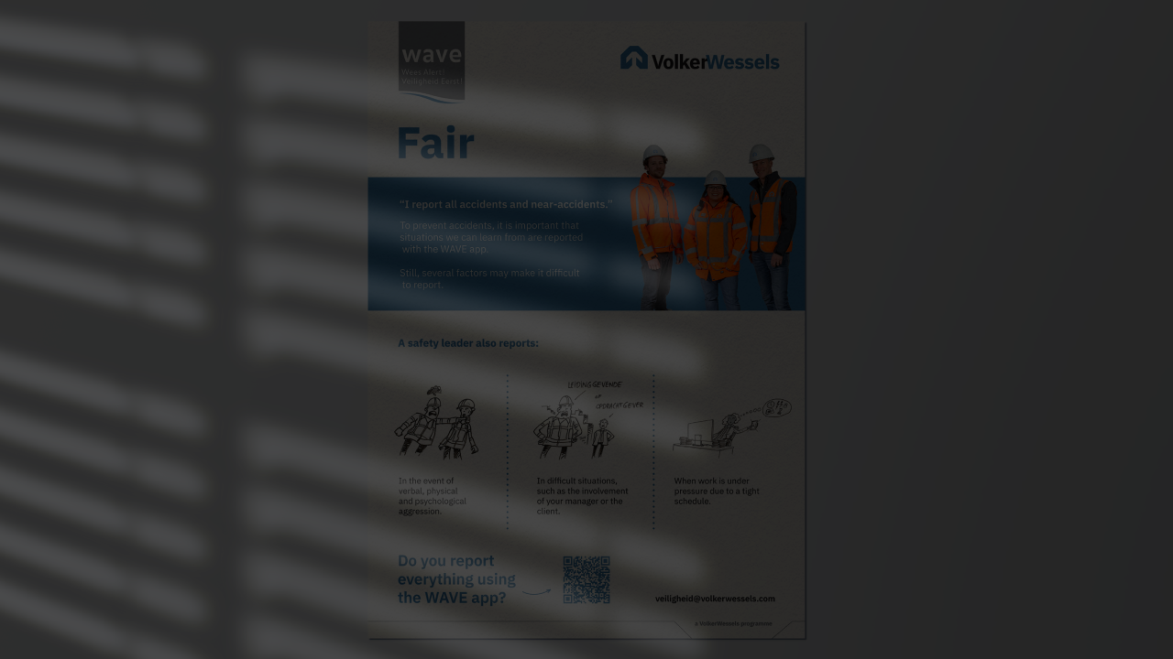
During which situations would you consider whether or not to report something so as not to harm yourself or others?
Please explain your answer.
Question
WAVE value: Fair

Slide 34
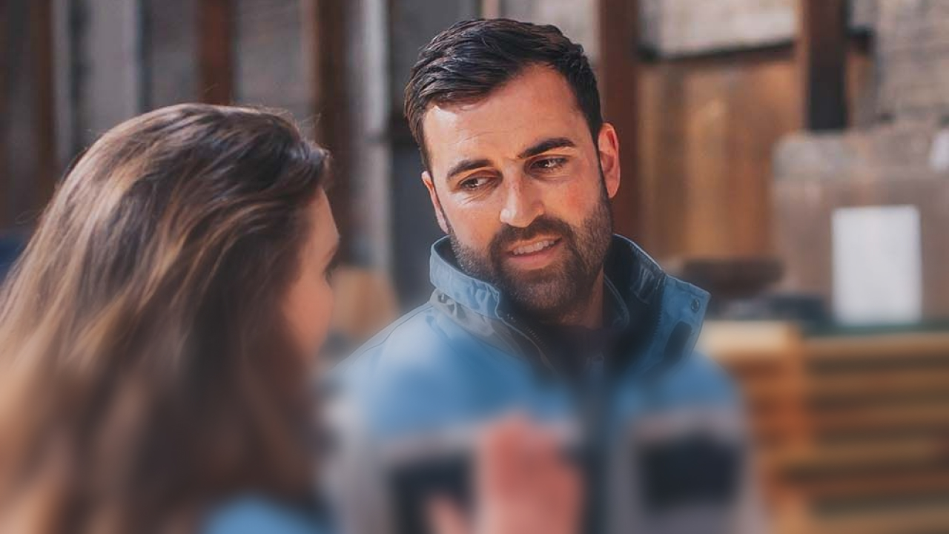
WAVE value: Open

Slide 36
Get your
bingo card ready!

Slide 37
48

Slide 38
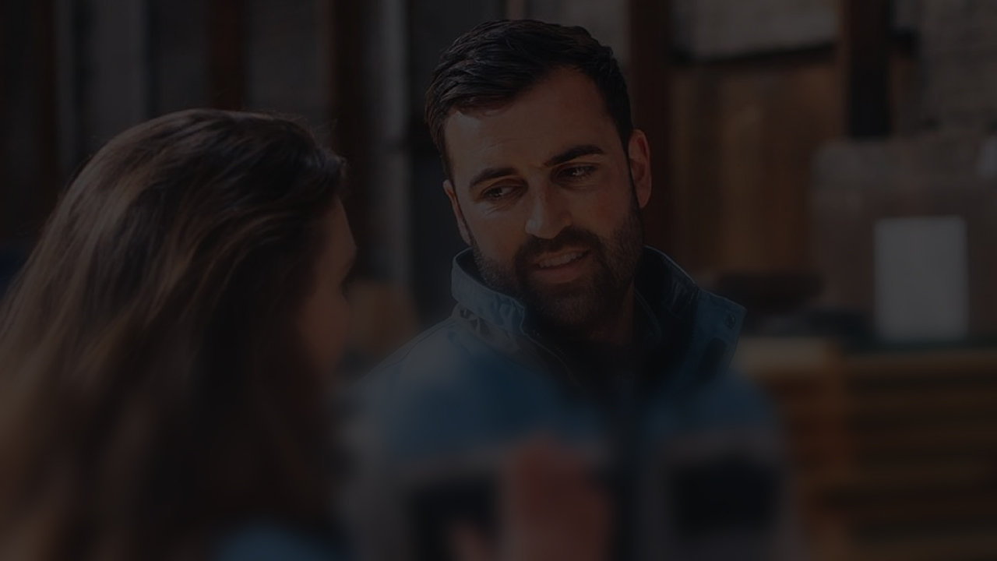
During the transfer of the documents from client to contractor, you discover that the plan you received for the H&S design phase is too general (especially the RI&E). You mention this to the client. They brush it aside.
Dilemma
WAVE value: Open

Slide 39
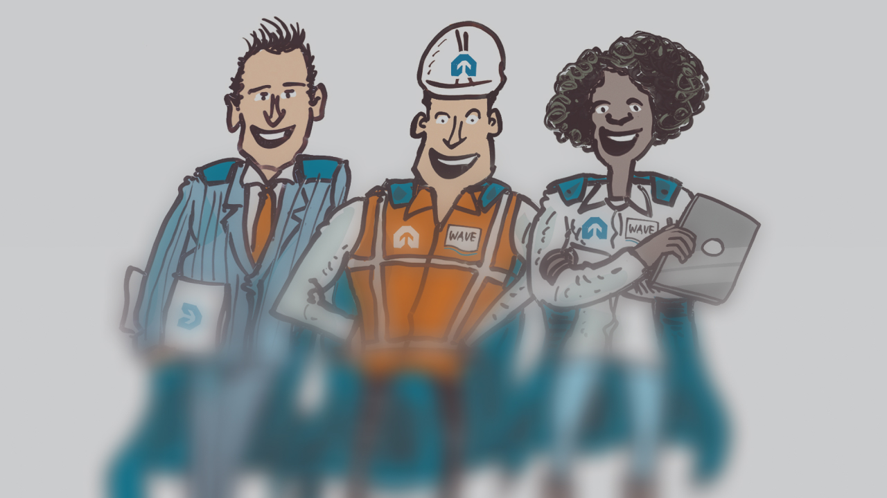
Safest colleague

Slide 40
Get your
bingo card ready!

Slide 41
10

Slide 42
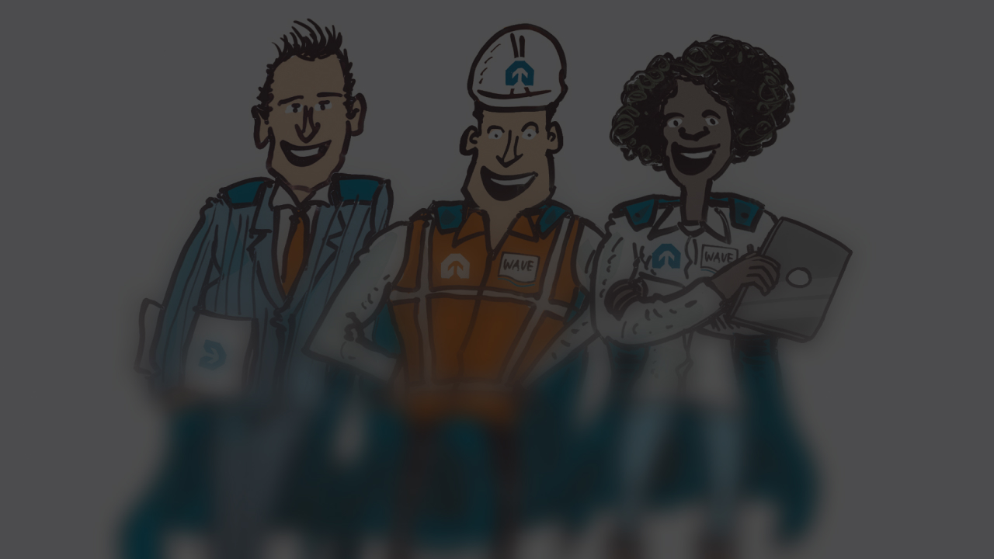
Who do you nominate for a Safe Working Compliment?
Please explain your answer.
By the way: Have you already awarded this colleague a Compliment in the WAVE app?
Question
Safest colleague

Slide 43
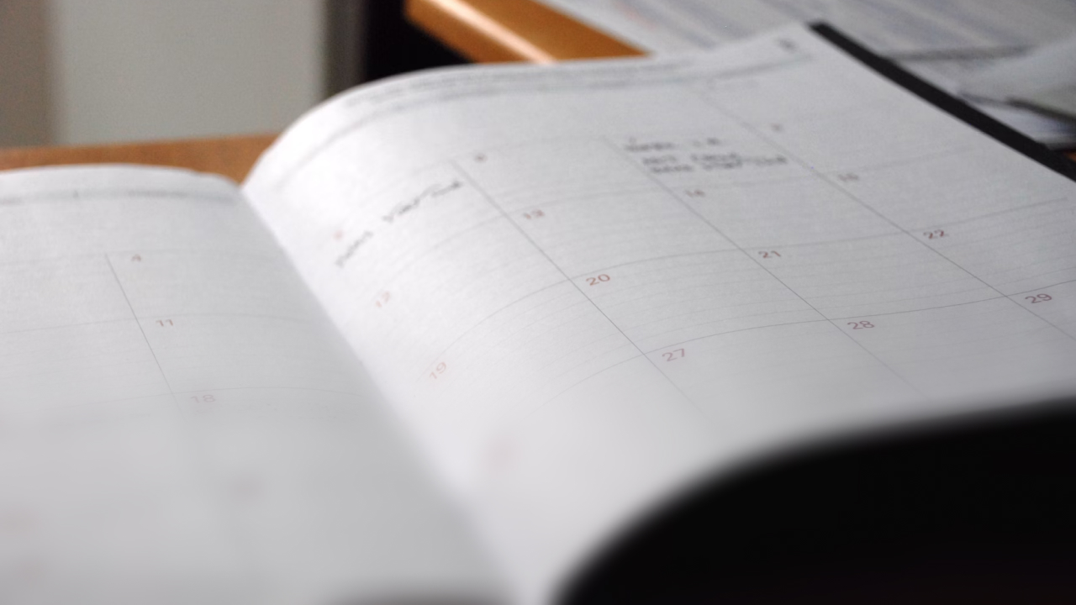
Overestimating your abilities?!

Slide 45
Get your
bingo card ready!

Slide 46
56

Slide 47
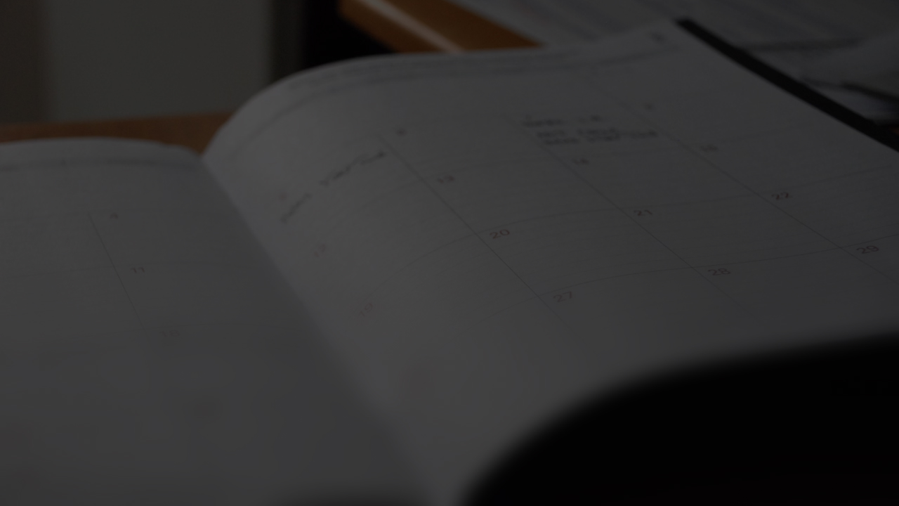
The most common form of overestimation is planning. Do you agree or disagree? What risk does this entail?
Do you ever overestimate your abilities?
Statement
Overestimating your abilities?!

Slide 48
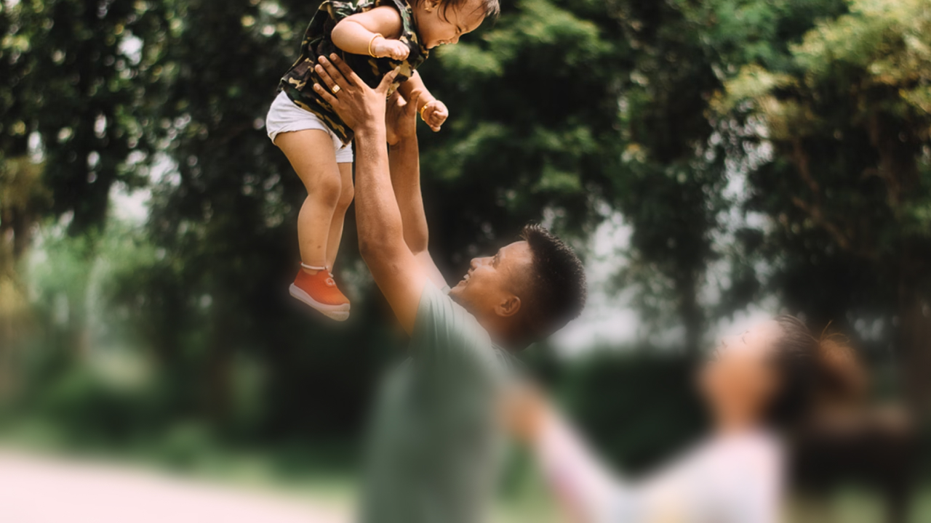
What's in it for you?

Slide 49
Get your
bingo card ready!

Slide 50
3

Slide 51
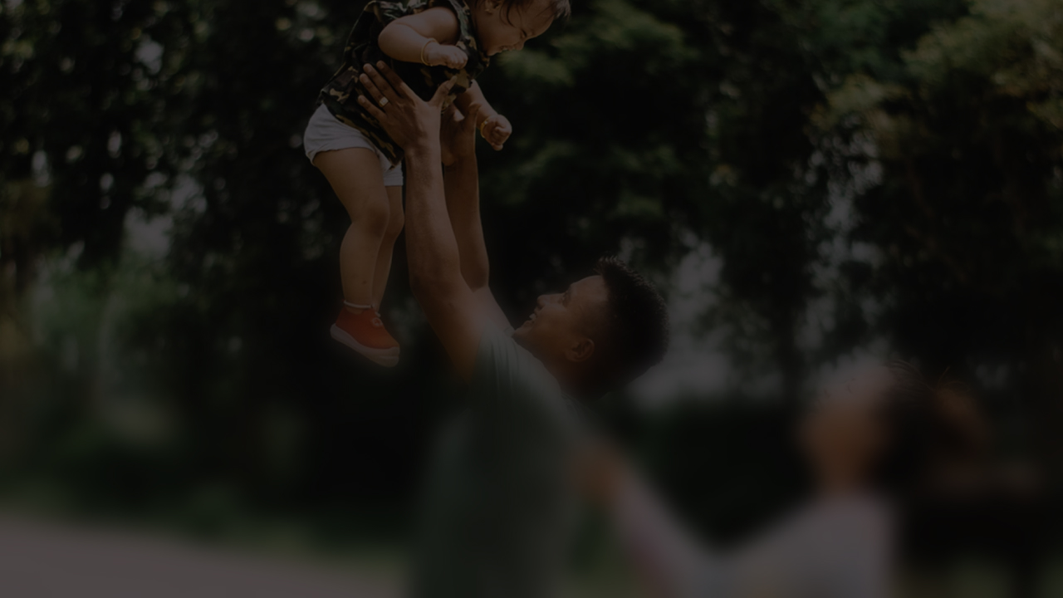
What is your personal motivation for working safely yourself and enabling others to work safely?
Question
What's in it for you?

Slide 52
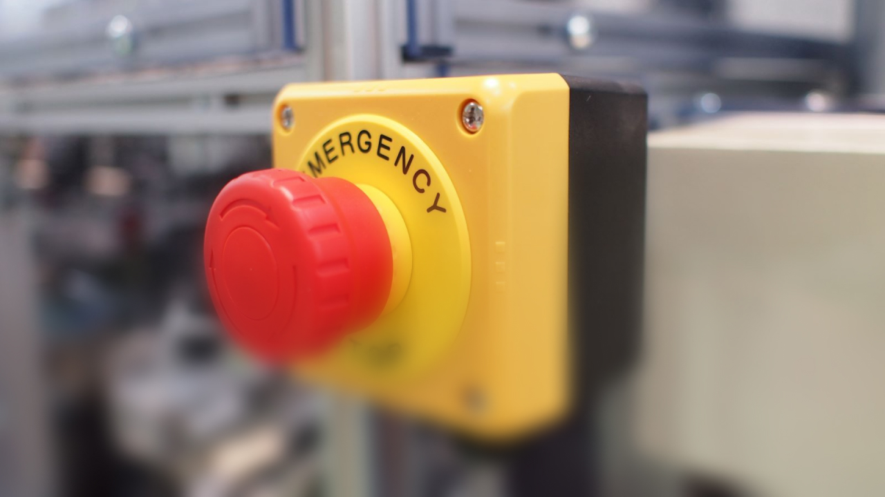
Warning sign

Slide 54
Get your
bingo card ready!

Slide 55
11

Slide 56
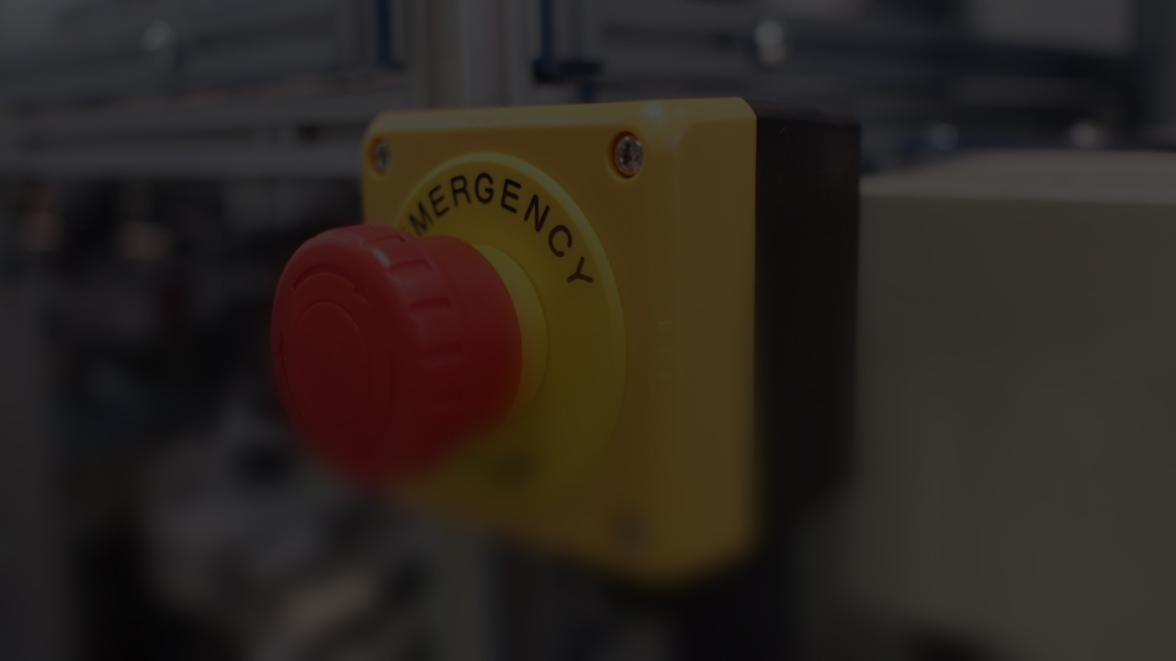
When was the last time you ever had doubts about a situation?
Why? And what did you do?
Question
Warning sign

Slide 57
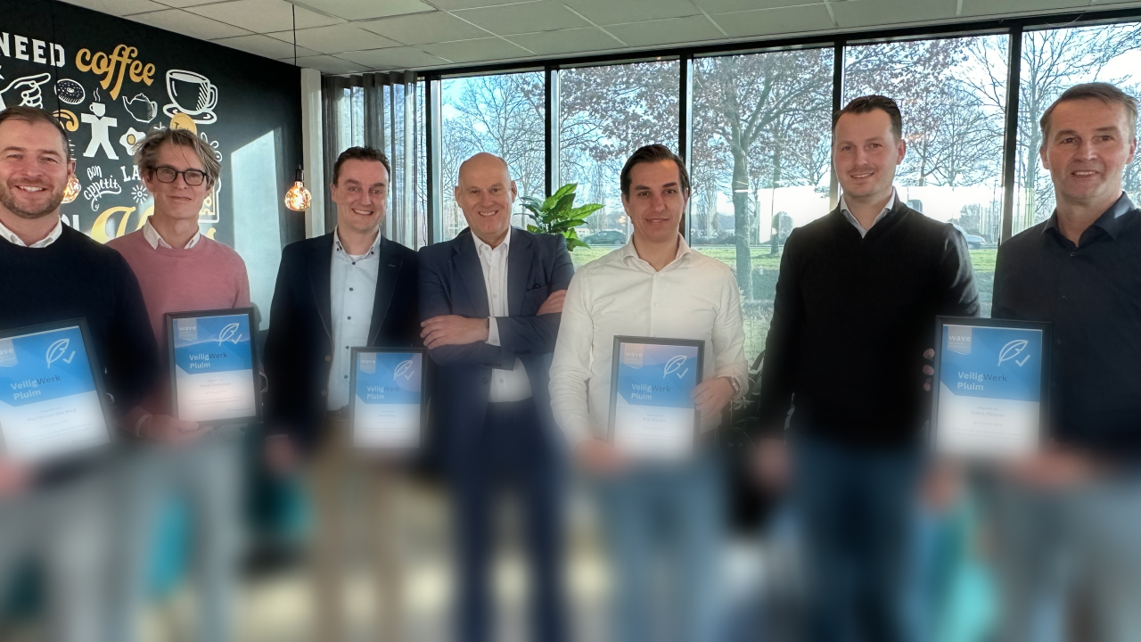
The difference

Slide 58
Get your
bingo card ready!

Slide 59
20

Slide 60
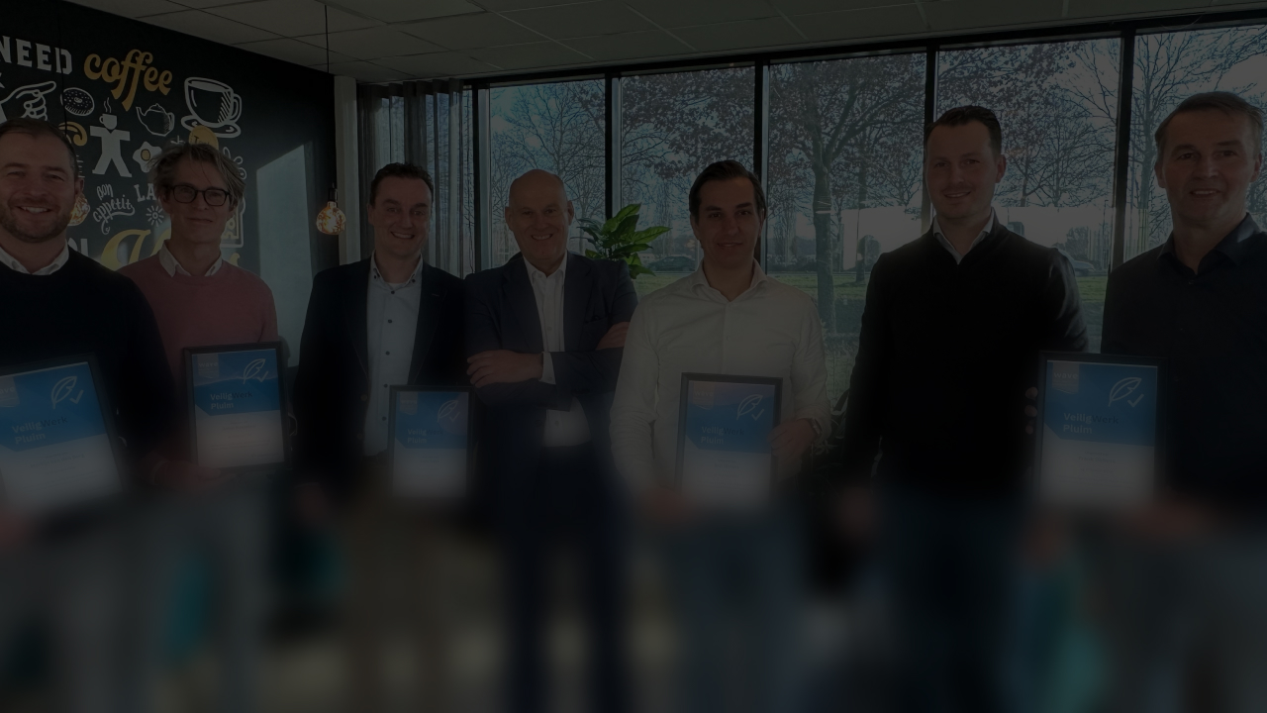
Do you have the feeling that you can make a difference in terms of safety within this organisation?
Please explain your answer.
If not, what do you think will have to change?
Question
The difference

Slide 62
