Slide 1
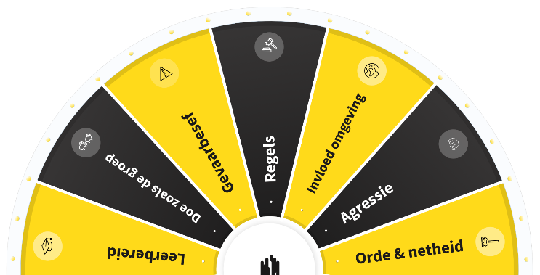
SAFETY DAY
GEARING UP SAFETY! WILL YOU HELP US TO ACCELERATE?
30 March 2022
START PRESENTATION

Slide 2


Do you know where to find the emergency exit?
Are you familiar with the assembly point of this building or the project location?
Gearing up safety! Will you help us to accelerate?

Slide 3
SAFETY DAY 2022
Background: how can we gear up our perception of safety?
  We are convinced that this can be realised by making safety more personal and by maintaining a dialogue with each other, for instance by using the 'WAVE accelerator'
Animation
  ‘Gearing up safety! Will you help us to accelerate?’
  Explanation of the game
Playing the game
Evaluation & feedback
Gearing up safety! Will you help us to accelerate?

Slide 4
Background
How can we gear up our perception of safety?
All too often, the subject of safety is still considered as something to quickly tick off in meetings, with the focus usually on 'the other' and the hard side of safety. However, it is more important to discuss safety behaviour to gain insight into what drives us in terms of safety.
By discussing safety in the workplace based on various topics (WAVE rules - values and key risks). Gain insight into each other's motivations and personal dilemmas by answering questions aimed at (each other's) safety behaviour.
Gearing up safety! Will you help us to accelerate?

Slide 5

Animation
  ‘Gearing up safety!
  Will you help us to accelerate?’
  Explanation of the game
Gearing up safety! Will you help us to accelerate?
Notes:
This animation can be found in different languages on the dedicated web page: https://www.volkerwessels.com/veiligheidsdag_2022
If the animation doesn’t open from the image, you can copy and paste this link into the browser: https://youtu.be/tksNVC-fMhc
NOTE: ALWAYS USE CHROME

Slide 6
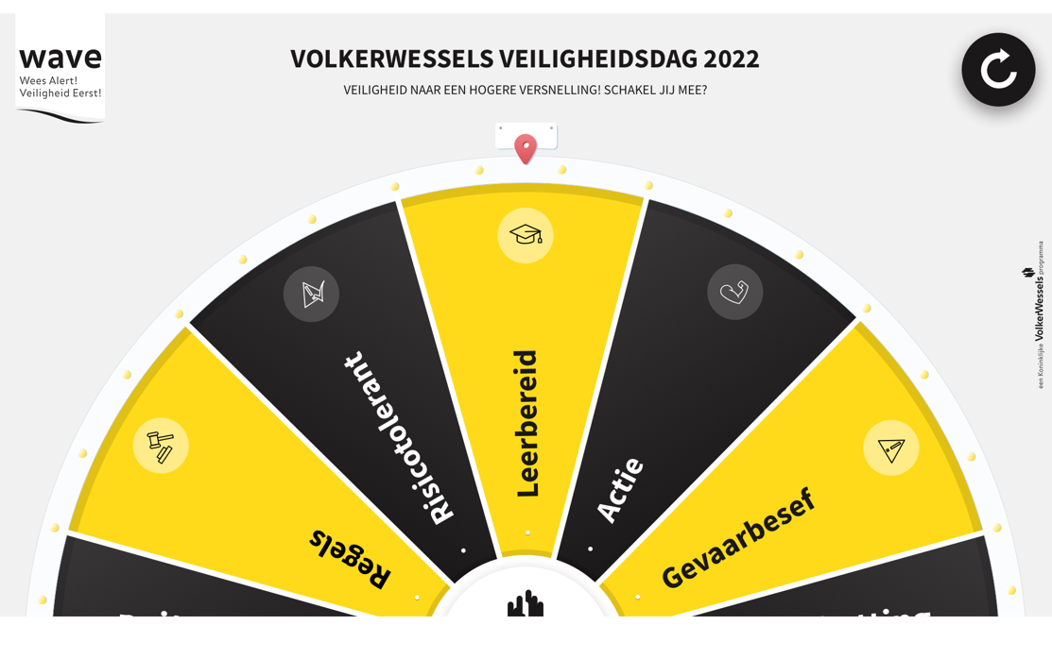
Playing the game
  Let’s play the game together!
Gearing up safety! Will you help us to accelerate?
Notes:
The game can be played via: https://veiligheidsdag2022.volkerwessels.com/ or by clicking on the image. !! NOTE: ALWAYS USE CHROME!
Username Dutch version: Veiligheid2022
Username English version: Veiligheid2022_ENG
Username Polish version: Veiligheid2022_PL
Username Turkish version: Veiligheid2022_TUR
Username Romanian version: Veiligheid2022_ROE
Username German version: Veiligheid2022_DUI
Username Bulgarian version: Veiligheid2022_BUL
Username Portuguese version: Veiligheid2022_PT
Password for all versions: Versnel
This can also be found in the instructor’s manual. It can also be found on the dedicated web page: https://www.volkerwessels.com/veiligheidsdag_2022

Slide 7
Evaluation and feedback
What was it like playing this game together?
What did you learn from it? Name something you didn't know about a colleague this morning.
What will you do differently at work tomorrow?
Gearing up safety! Will you help us to accelerate?
Notes:
Evaluation: discuss the questions on the sheet with each other.
Feedback: make a brief summary of the day and send it to veiligheid@volkerwessels.com, along with a photo

Slide 8
GEARING UP SAFETY! WILL YOU HELP US TO ACCELERATE?
Gearing up safety! Will you help us to accelerate?

