Slide 1
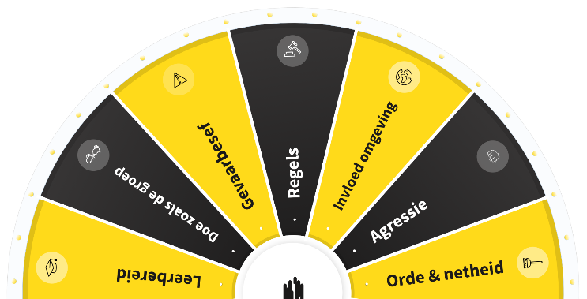
SAFETY DAY
GEARING UP SAFETY! WILL YOU HELP US TO ACCELERATE?
30 March 2022
ROADMAP FOR BUSINESSES
[this roadmap can be supplemented with your own ideas]

Slide 2
INTRODUCTION
We do everything we can to prevent accidents and personal suffering regarding colleagues who work for or on behalf of us. We also want to prevent damage to the environment in which we work or to prevent third parties from sustaining personal injury as a result of our work.
In practice, it is sometimes quite difficult to insist on working safely. Too often, we think that a job can be done quickly or that achieving the schedule is more important than working safely. We know this and we are working hard to work more and more safely through our own WAVE programme.
Making dilemmas at our projects and office locations open for discussion with employees will help us to move forward. That is why, during the safety day this year too, the focus is on safety dilemmas, the WAVE safety values and WAVE rules, practical examples and our own safety behaviour. This is done, as in previous years, by playing a safety game.
Gearing up safety! Will you help us to accelerate?

Slide 3
BACKGROUND
All too often, the subject of safety is still considered as something to quickly tick off in meetings, with the focus usually on 'the other' and the hard side of safety. However, it is more important to discuss safety behaviour to gain insight into what drives us in terms of safety and to find out why we make certain choices.
Gearing up safety! Will you help us to accelerate?

Slide 4
OBJECTIVE
Discuss safety in the workplace based on various topics (WAVE rules - values and key risks). Gain insight into each other's motivations and personal dilemmas by answering questions aimed at (each other's) safety behaviour.
Increase safety awareness on the various topics.
Encourage people to think about their own influence on working (more) safely.
Gearing up safety! Will you help us to accelerate?

Slide 5
MESSAGE
"How can we gear up our perception of safety? We are convinced that this can be realised by making safety more personal and by maintaining a dialogue with each other".
Gearing up safety! Will you help us to accelerate?

Slide 6
TARGET GROUP
VolkerWessels companies
It is mandatory for all VolkerWessels companies (excluding foreign countries) to participate in the Safety Day.
Who takes part?
All own employees.
Hired independent contractors.
Other hired and seconded personnel.
Optional but highly desirable: personnel of subcontractors and other contractors.
VolkerWessels companies can decide for themselves whether or not they involve this target group.
Gearing up safety! Will you help us to accelerate?

Slide 7
MINIMUM REQUIREMENTS
The following minimum requirements must be met:
The Safety Day is held at the companies’ (project) locations or for office staff, for example, via Teams. This depends in part on the COVID-19 measures that will be in place on 30 March.
The WAVE accelerator is discussed for at least 45 minutes to an hour. In total, each session will require approximately 60 minutes.
The presentation is used as a basis. Of course, the presentation can be supplemented with other safety topics that the company also wants to discuss during this day.
Each VolkerWessels company itself determines the further details of this day.
Gearing up safety! Will you help us to accelerate?

Slide 8
RESOURCES
Poster, save-the-date poster, save-the-date-desktop, manual for instructors, start presentation (incl. animation) and digital safety game.
The WAVE accelerator card game and accompanying tear-off calendar will be shared with the companies in the first week of May 2022.
Gearing up safety! Will you help us to accelerate?

Slide 9
POSSIBLE SPECIFICS - OFFICE
Kick-off by the board or executive management of office staff
The strength of the programme is that it sparks a discussion among the employees. This truly gets us discussing safety. We are convinced that everyone has an influence on working safely and the prevention of accidents. Safety is not limited to the building site.
Required tools
Beamer, laptop, sound and start presentation.
NOTE: The digital safety game is only accessible through Chrome, not through Internet Explorer.
Gearing up safety! Will you help us to accelerate?

Slide 10
POSSIBLE SPECIFICS - PROJECT
Meetings (project) locations
The management and board visit projects to set up safety day. Chances are that management and the board will visit multiple projects. The VolkerWessels company itself will specify this.
The strength of the programme is that it sparks a discussion among the employees. This truly gets us discussing safety.
Required tools
Beamer, laptop, sound and start presentation.
NOTE: The digital safety game is only accessible through Chrome, not through Internet Explorer.
Gearing up safety! Will you help us to accelerate?

Slide 11
EVALUATION AND FEEDBACK
Within your company (minimum):
What was it like to play the WAVE accelerator together?
What did you learn from it?
What will you do differently at work tomorrow?
Feedback from the VolkerWessels companies to VolkerWessels:
No formal feedback requested. Would like pictures and quotes from participants.
Good ideas, experiences and other outcomes from, for example, the evaluation within your company or from the instructor are always welcome. Very much so!
Mail this to veiligheid@volkerwessels.com.
At the latest 3 weeks after the safety day, VolkerWessels will provide feedback on the day.
Gearing up safety! Will you help us to accelerate?

Slide 12
GOOD LUCK WITH THE PREPARATIONS!
Gearing up safety! Will you help us to accelerate?

